Slide 1
State Machine Design
Digital Electronics
© 2014 Project Lead The Way, Inc.

Slide 2
State Machine Design
This presentation will
Define a state machine and Illustrate the block diagram for a state machine.
Provide several examples of everyday items that are controlled by state machines.
Describe the steps in the state machine design process.
Provide an example of a state machine design.
Notes:
Introductory Slide / Overview of Presentation

Slide 3
State Machine
A synchronous sequential circuit, consisting of a sequential logic section and a combinational logic section, whose outputs and internal flip-flops progress through a predictable sequence of states in response to a clock and other input signals.∗
Input
Combo
Logic
Memory
Flip-Flops
Output
Combo Logic
Output(s)
Input(s)
Clock
Notes:
Floyd, T. (2006). Digital fundamentals. Upper Saddle River, NY: Pearson Education.
A state machine uses combinational and sequential logic to make decisions on outputs based on the inputs. A state machine will “hold” a state until a new set of inputs are given.

Slide 4
Parts of a State Machine
Input Combinational Logic
Memory
Output Combinational Logic
Input
Combo
Logic
Memory
Flip-Flops
Output
Combo Logic
Output(s)
Input(s)
Clock
Notes:
Floyd, T. (2006). Digital fundamentals. Upper Saddle River, NY: Pearson Education.

Slide 5
Input Combinational Logic
What should happen next based on the buttons, switches, and other inputs?
Input
Combo
Logic
Memory
Flip-Flops
Output
Combo Logic
Output(s)
Input(s)
Clock
Notes:
Floyd, T. (2006). Digital fundamentals. Upper Saddle River, NY: Pearson Education.

Slide 6
Memory
Flip-Flops determine the number of states in the design and trigger the state transitions based on the inputs.
Input
Combo
Logic
Memory
Flip-Flops
Output
Combo Logic
Output(s)
Input(s)
Clock
Notes:
Floyd, T. (2006). Digital fundamentals. Upper Saddle River, NY: Pearson Education.

Slide 7
Output Combinational Logic
What should motors, indicators, and other outputs do once the flip-flops have caused the transition to a new state?
Input
Combo
Logic
Memory
Flip-Flops
Output
Combo Logic
Output(s)
Input(s)
Clock
Notes:
Floyd, T. (2006). Digital fundamentals. Upper Saddle River, NY: Pearson Education.

Slide 8



Examples of State Machines
Many everyday devices are controlled by state machines.
Traffic Lights
Garage Door Numeric Keypads
Vending Machines
Notes:
This slide provides three simple state machine applications. Ask students to consider other applications that they think may utilize state machines.

Slide 9
State Machine Design
Create a State Graph
  Determine the number of States and label
  Determine the number of State Variables and label (How many flip-flops needed?)
  Label Outputs and Encode Outputs to States
Create State Transition Table from the State Graph
Write and Simplify Design Equations from the State Transition Table
Design Circuit

Slide 10
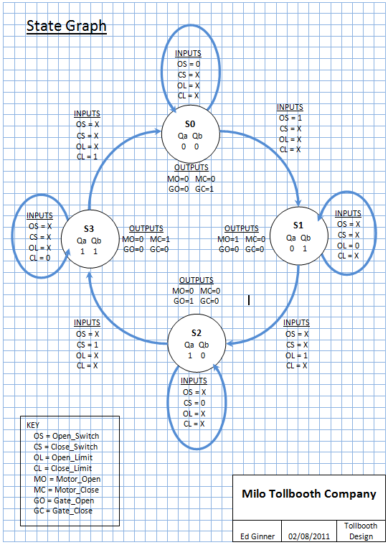
State Graphs
A state graph shows the sequence of states that the state machine will transition to on each clock transition.
This is an example of a state graph with four states (S0-S3).
Notes:
We will study this state graph in detail later. Right now, just focus on the parts of the state graph and how they are related.

Slide 11
State Graphs
Each state “bubble” is labeled (S0,S1,S2,S3). These labels are arbitrary.
Each transition arc is labeled with the values of the input variables that make the transition occur.

Slide 12
Anatomy of a State Graph
Transition Arc
(For Input X=0)
Hold State
Input Variable (X)
X = 0
S0
State (S0)
State “Bubble”
Qa Qb
0 0
Y=0 & Z=1
X = 1
Transition Arc
(For Input X=1)
Next State
State Variables
(Qa & Qb)
Output Variables
(Y & Z)
Next
State “Bubble”
Notes:
A state graph shows the sequence of states that the state machine will transition to on each clock transition.
Each state “bubble” is labeled (S0, S1, S2). (These labels are arbitrary.)
Each transition arc is labeled with the value(s) of the input variable(s) that make the transition occur.
The state variables are the outputs of the flip-flops, so they are typically called Qa, Qb, Qc, Qd, etc. (These labels are arbitrary.)
The number of state variables is determined by the number of states according the following function:
# States <= 2^{(# state variables)} ;
For example:
2 States Requires - 1 State Variable
4 States Requires - 2 State Variable
8 States Requires - 3 State Variable
16 States Requires - 4 State Variable
There will be the occasion when a design has unused states. For example, if your design requires 6 states, you will need 3 state variables (6 <= 2³). Thus, there will be a total of eight states (2³ = 8), and only six will be used.
Each state is assigned output values for when the state machine is in that state.

Slide 13
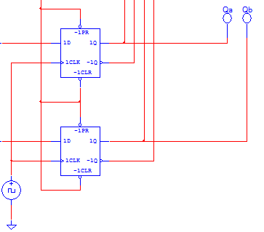
State Variables
The state variables are actually the outputs of the memory flip-flops.
For that reason they are typically labeled Qa, Qb, etc.
S0
Qa Qb
0 0
This four state example would require (2) flip-flip (Qa and Qb)
to clock through four states (S0-S3).
1st State (SO) Qa Qb = 0 0
2nd State (S1) Qa Qb = 0 1
3rd State (S2) Qa Qb = 1 0
4th State (S3) Qa Qb = 1 1

Slide 14
State Variables
If a 5th state was needed:
Can you guess how many flip-flops and state variables you would need?
(It is not possible to have exactly 5 states)
How many states would go un-used?
1st State (SO) Qa Qb = 0 0
2nd State (S1) Qa Qb = 0 1
3rd State (S2) Qa Qb = 1 0
4th State (S3) Qa Qb = 1 1
5th Sate (S4) ??????? = ?????
Notes:
3 flip-flops = 8 possible states
5 states = 3 unused

Slide 15
Output Variables
Each state “bubble” is assigned output variables.
This example has 4 output variables based on what state it is in.

Slide 16
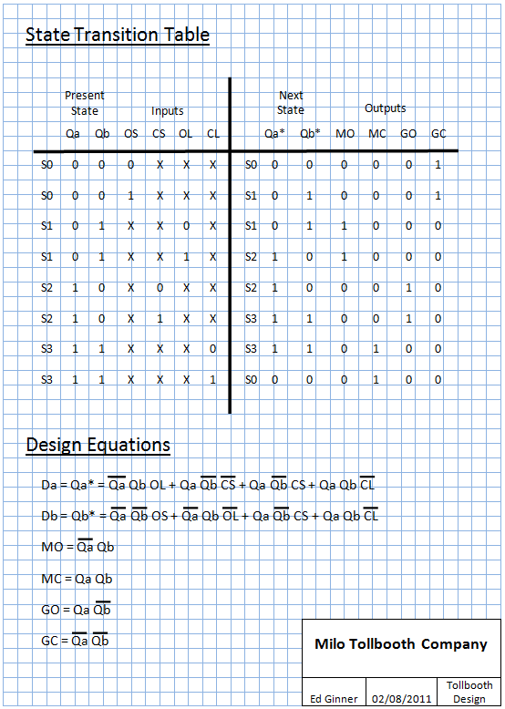
State Graphs to
State Transition Tables

Slide 17
State Transition Tables
State Transition Tables are then created from the State Graph.
They describe the Present State (inputs) and the Next State (outputs) associated with each state (S0-S3).

Slide 18
State Transition Tables
Notice that each state occupies 2 lines on the State Transition Table.
That is because (in this example) each transition is triggered by only one of 4 possible inputs at any time.
For: Input that causes transition:
S0 OS = 0 ;OS = 1
S1 OL = 0 ;OS = 1
S2 CS = 0 ;CS =1
S3 CL = 0 ;CL = 1

Slide 19
State Transition Tables
In a state machine, the Next State is actually the output from the Memory flip-flops (Qa* Qb*) when an input is changed.
Qa* = Da for the next state
on one flip-flop and
Qb* = Db for the next state
on the other flip-flop

Slide 20
State Transition Tables
The outputs from the Memory flip-flops are linked to the Input Combinational Logic.
That way a transition is made on the next clock signal to the next state.
Qa* = Da for the next state
on one flip-flop and
Qb* = Db for the next state
on the other flip-flop
Input
Combo
Logic
Memory
Flip-Flops
Output
Combo Logic
Output(s)
Input(s)
Clock

Slide 21
Design Equations
From the State Transition Table you can now determine the un-simplified expressions for the:
Input Combinational Logic
Da=Qa*
Db=Qb*
Output Combinational Logic
This example has (4) outputs
MO – Motor Open Signal
MC – Motor Close Signal
GO – Gate Open Indicator
GC – Gate Closed Indicator

Slide 22
State Machine Design Example
  Design a state machine that will count out the last four digits of a phone number ONLY when an Enable pushbutton is pressed. The output should hold the last number until the Enable button is pressed again. (Example 585-476-4691)
  Whenever the Enable is a logic (1), the outputs will continuously cycle through the four values 4,6,9,1. Whenever the Enable is a logic (0), the outputs will hold at their current values.
  For this design any form of combinational logic may be used, but the sequential logic must be limited to D flip-flops.
“4” → “6” → “9” → “1”
Phone
Numbers
C3
C2
C1
C0
Enable
Clock

Slide 23
Step 1:
Create State Graph (# of States?)
EN = 0
S0
EN = 1
“4”
EN = 1
EN = 0
S3
S1
EN = 0
“1”
“6”
S2
EN = 1
“9”
EN = 1
EN = 0
Notes:
This design has only one input (EN), so each state bubble should have two transition arcs, one for EN=0 and one for EN=1.
This design has four possible output conditions (“4” – “6” – “9” – “1”); thus, the design requires four state bubbles.

Slide 24
Step 2:
Determine # of State Variables and Assign
EN = 0
S0
EN = 1
Qa Qb
0 0
“4”
EN = 1
EN = 0
S3
S1
EN = 0
Qa Qb
1 1
“1”
Qa Qb
0 1
“6”
S2
EN = 1
Qa Qb
1 0
“9”
EN = 1
EN = 0
Notes:
With four states, this design requires two state variables (4 = 2²). These state variables are labeled Qa and Qb. This labeling is arbitrary but does use the recommended Q notation (these are the flip-flop outputs). Note: Qx and Qy or Q0 and Q1 would also work.
The four combinations of the two state variables (00, 01, 10, and 11) are assigned to the four states (S0, S1, S2, S3).

Slide 25
Step 3:
Encode Outputs to States (# Displayed?)
EN = 0
S0
EN = 1
Qa Qb
0 0
“4”
EN = 1
EN = 0
S3
0100
C3=0 C2=1 C1=0 C0=0
S1
EN = 0
Qa Qb
1 1
“1”
Qa Qb
0 1
“6”
1001
C3=1 C2=0 C1=0 C0=1
0001
C3=0 C2=0 C1=0 C0=1
S2
0110
C3=0 C2=1 C1=1 C0=0
EN = 1
Qa Qb
1 0
“9”
EN = 1
EN = 0
Notes:
In order to display the output in binary, encode from base-ten output count into base-two (binary). Because the largest output count is “9”, four output variables are needed to represent this number in binary (“9” = 1001). These output variables will be labeled C3, C2, C1, and C0.
Thus, for example, in state S0 the output “4” encoded into binary would be 0100 (C3=0, C2=1, C1=0, and C0=0).
Repeat this process for the three remaining states.

Slide 26
Step 4:
Create State Transition Table
State | Inputs |  |  | State | Outputs
 | Present State |  | Input |  | Next State |  | F/F Inputs |  | Encoded Outputs
 | Qa | Qb | EN |  | Qa* | Qb* | Da | Db | C3 | C2 | C1 | C0
S0 | 0 | 0 | 0 | S0 | 0 | 0 | 0 | 0 | 0 | 1 | 0 | 0
S0 | 0 | 0 | 1 | S1 | 0 | 1 | 0 | 1 | 0 | 1 | 0 | 0
S1 | 0 | 1 | 0 | S1 | 0 | 1 | 0 | 1 | 0 | 1 | 1 | 0
S1 | 0 | 1 | 1 | S2 | 1 | 0 | 1 | 0 | 0 | 1 | 1 | 0
S2 | 1 | 0 | 0 | S2 | 1 | 0 | 1 | 0 | 1 | 0 | 0 | 1
S2 | 1 | 0 | 1 | S3 | 1 | 1 | 1 | 1 | 1 | 0 | 0 | 1
S3 | 1 | 1 | 0 | S3 | 1 | 1 | 1 | 1 | 0 | 0 | 0 | 1
S3 | 1 | 1 | 1 | S0 | 0 | 0 | 0 | 0 | 0 | 0 | 0 | 1
See Slide Notes for a detailed description
Notes:
State transition table for the design example.
Each state has 2 lines on the state transition table. One line for EN=0 (hold state) and one line for EN=1 (next state).
Note: Even though the EN may have switched from EN=0 to EN=1 in the first 2 lines of the table, the encoded output DOES NOT CHANGE until the clock signal transitions the circuit to the next state. The encoded outputs for both lines of SO are the same. You will designate the NEXT STATE Qa* Qb* on the outputs side of the table, but you DO not change the Encoded Output. (Imagine that the clock signal occurs when you reach the far right of the table and can then move down to the next line with a new encoded output.)

Slide 27
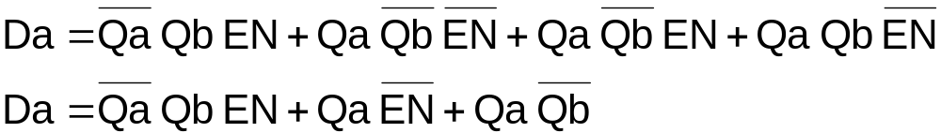
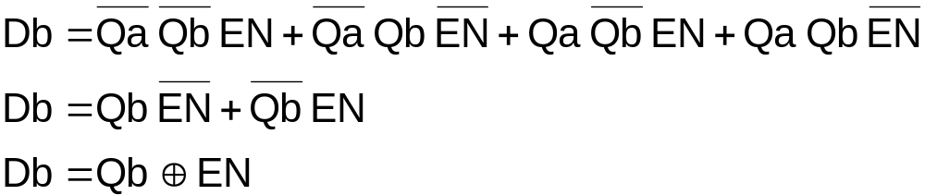
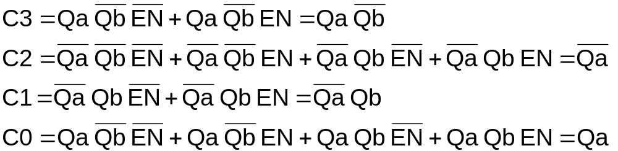
Step 5:
Write and Simplify Design Equations
Notes:
These are the design equations. The simplification (Boolean or K-Mapping) is left as a potential exercise for the students.

Slide 28
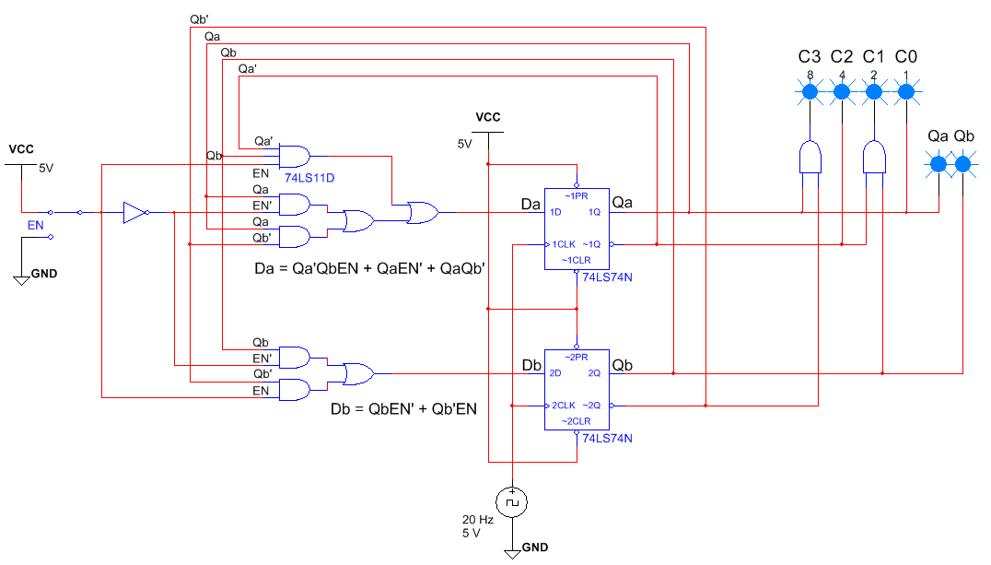
Step 6:
Circuit Design – AOI Simplified
Can you think of a better way to impliment the logic for Db ?
Notes:
Can you think of a better way to impliment the logic for Db ?

Slide 29
Step 7:
Circuit Design – Simplified Further?
Notes:
These are the design equations. The simplification (Boolean or K-Mapping) is left as a potential exercise for the students.

Slide 30
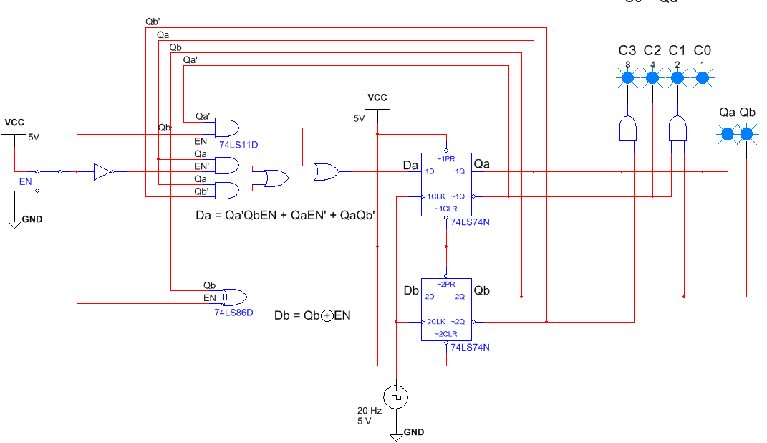
Step 8:
Circuit Design – Simplified Further XOR
Notes:
Student should recognize the exsclusive or logic.

Slide 31
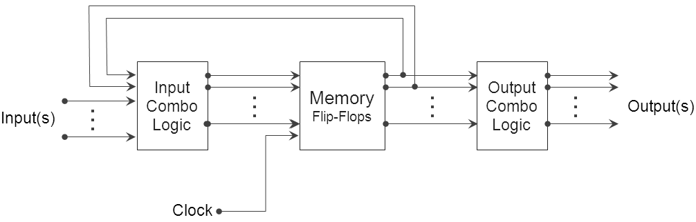
State Machine Block Diagram / Schematic
Notes:
Mapping of the final state machine design to the general block diagram for a state machine. The final output from the state machine can then be the input into a BCD seven segment decoder. This will allow the phone number to be viewed on a 7-segment display.

