Slide 1

Researching Current and Past Solutions
Engineering Design and Development

Slide 2
Similar Solutions
What is out there attempting to solve this problem?
Allows student to balance past attempts at solving solution with current problems.
Expands the students knowledge base.
Gives student ideas to creating their own design.
Helps to prove there still is a problem.

Slide 3
Where do you find like solutions?
Research
  Commercial Search
  United States Patent Office. www.uspto.gov
Catalogs and vendor resources
Qualified Experts
Interviews

Slide 4
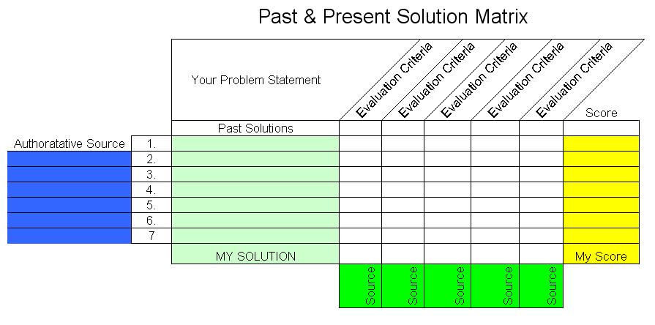
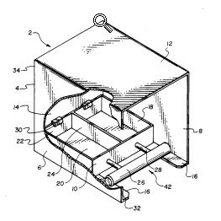
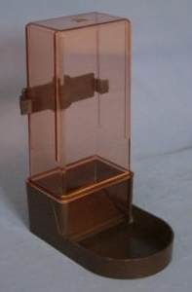
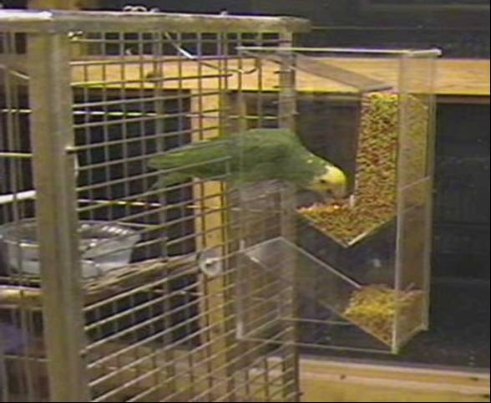

Mess-free bird feeder
BirdMangerTM
Parrot Fountain Feeder

Slide 5


Mess-free bird feeder
BirdMangerTM
Pros
Shielded entryway
Water and food separation
Cons
No Hanger
Metal Covering will Oxidize
Hard to Refill
Pros
Lightweight
Large capacity
Inexpensive
Cons
Not for outdoors
Will not stop ants
Hard to refill

Slide 6

Searching Patents

Slide 7

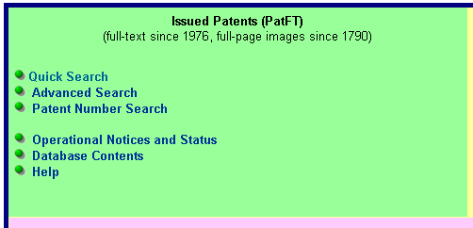
Search link
http://www.uspto.gov

Slide 8
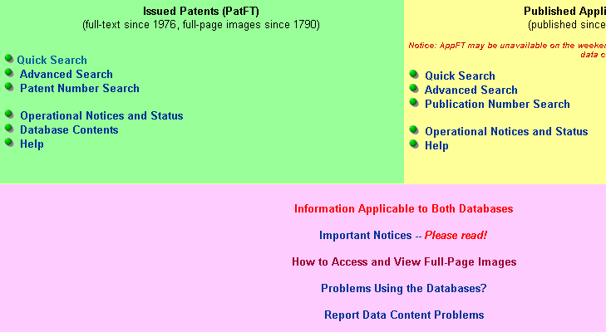

Slide 9
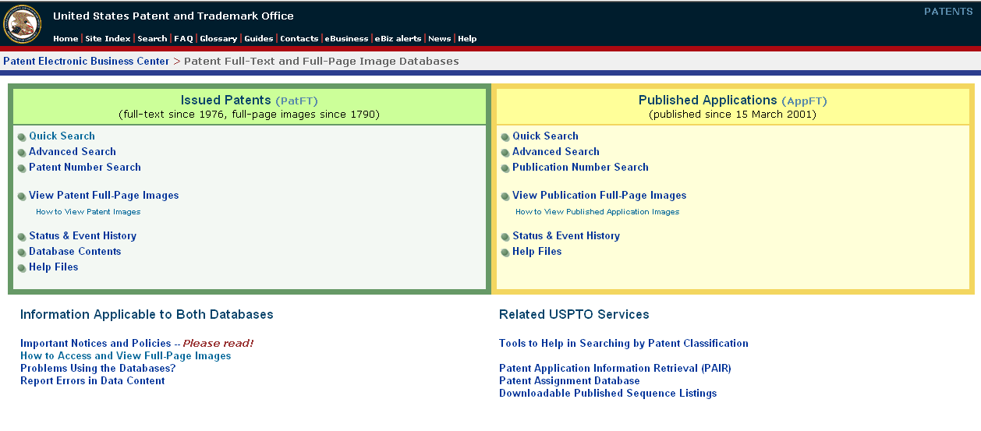
Search Link
Install Tiff Viewer

Slide 10
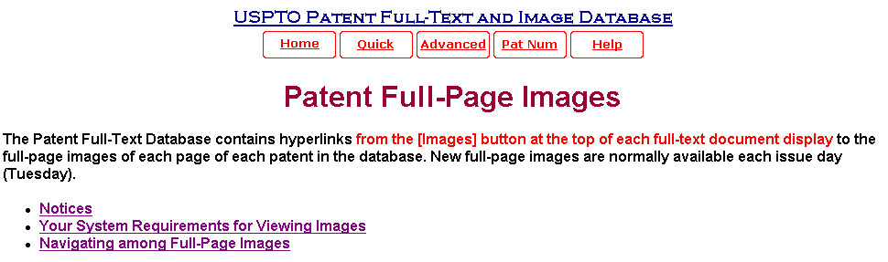
Patent Viewing requires a TIFF viewer. This can be downloaded from the USPTO or from commercial software.

Slide 11
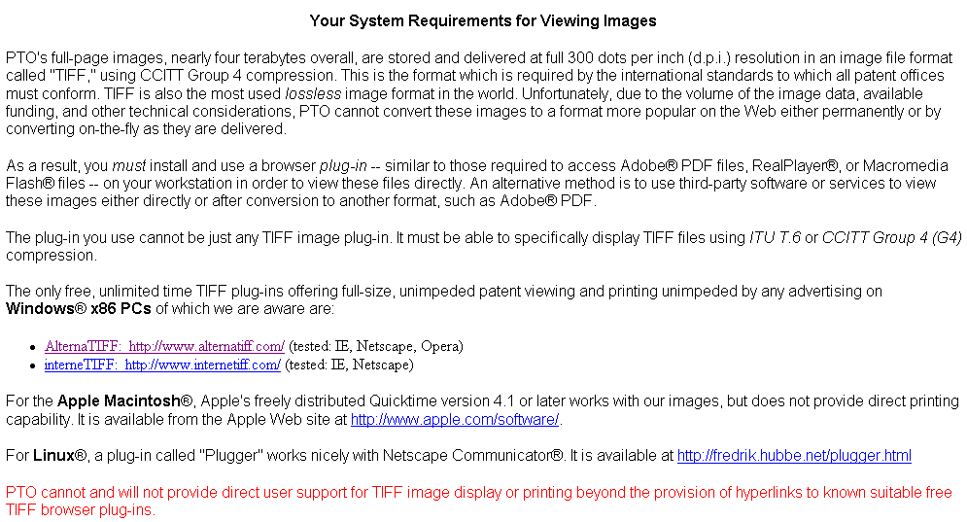
TIFF Viewer Download Link

Slide 12
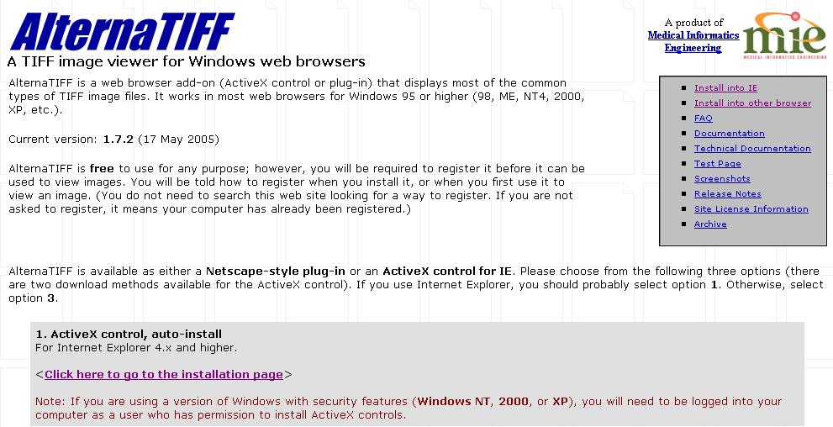
Company Download Link…Follow installation instructions

Slide 13
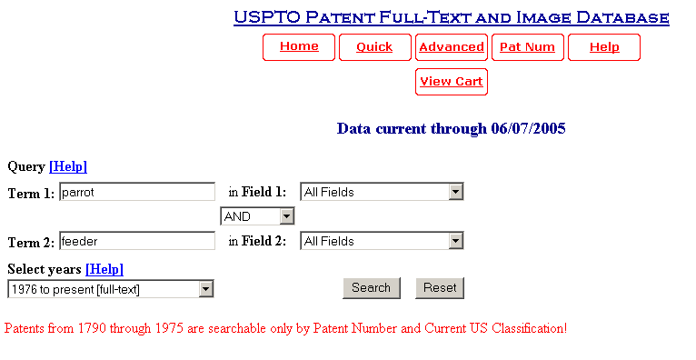
Search Terms

Slide 14
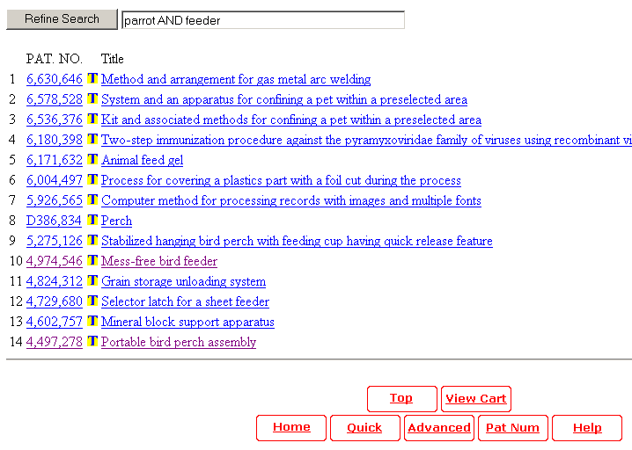

Slide 15
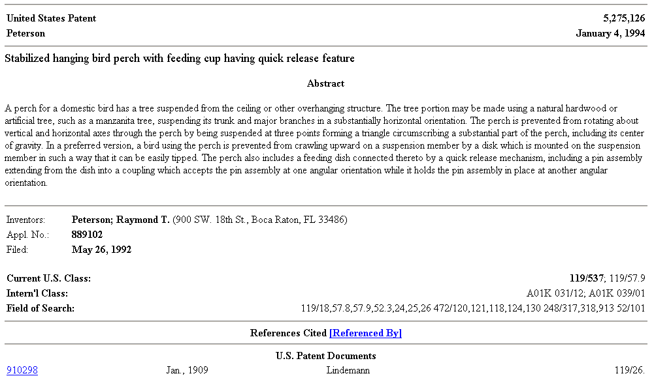
Abstract with Inventors Name, Date, Classification and Sub Classification Number

Slide 16
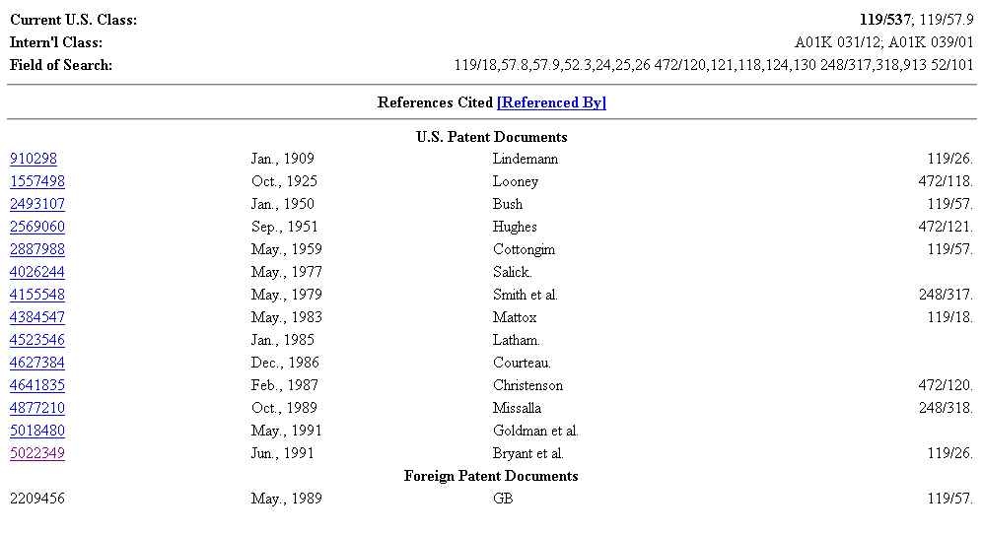
Referenced Patents used by inventor…added sources

Slide 17
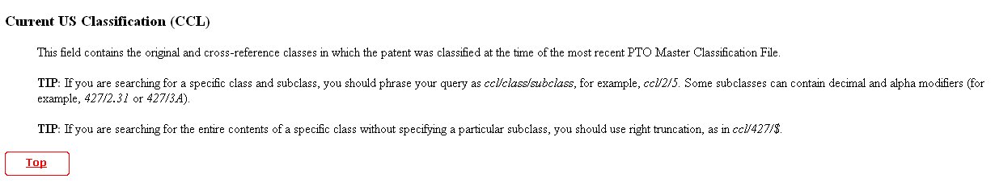
Classification Prefix
Classification Number help define and refine search for patents

Slide 18
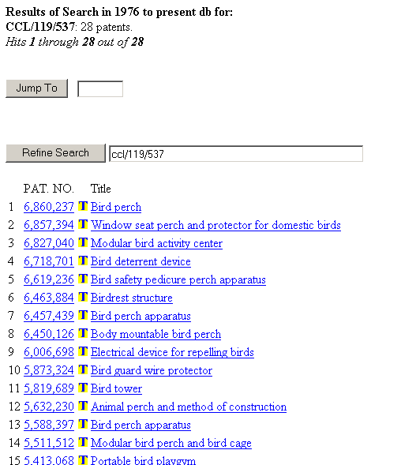
Searching by Classification Numbers and Sub classifications
(Birding Apparatuses)

Slide 19
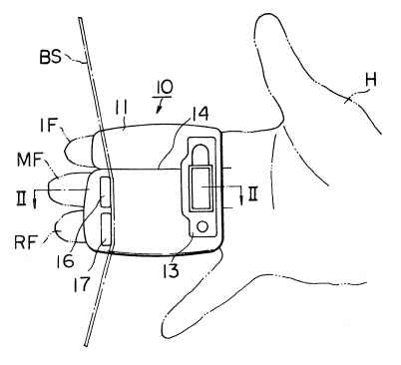
Pro’s
Easy to put on
Easy to carry
Prevents bowstring from slipping
Con’s
Requires adjustment of fingers to prevent “pinching” the arrow
The raised bumps will interfere with the bowstring and cause the archer to improperly release.

Slide 20
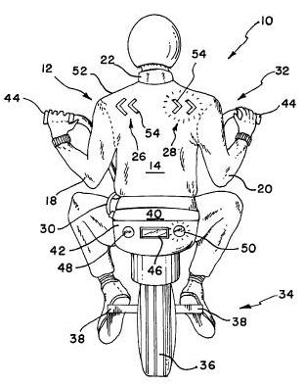
Motorcycle jacket with Turn Signals
Pro’s
  Wearable
  Bright Led's
  Wires are sewn into the jacket
Con’s
  Can get damaged in bad weather
  Requires a big box for power.

Slide 21
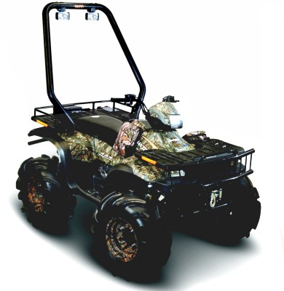
Past and Present
Solutions
Pros
  Provides extra light
  Allows range of motion
  Fits any model
Cons
  Not designed or strong enough
  Bad positioning for roll-over
Yamaha ATV Light Bar

Slide 22
Document the Search
Where did you search?
When?
What were the key words on boolean operators you used?
How many hits?
How many were relevant?

