Slide 1
Selecting a Solution Path
Engineering Design and Development
© 2013 Project Lead The Way, Inc.

Slide 2
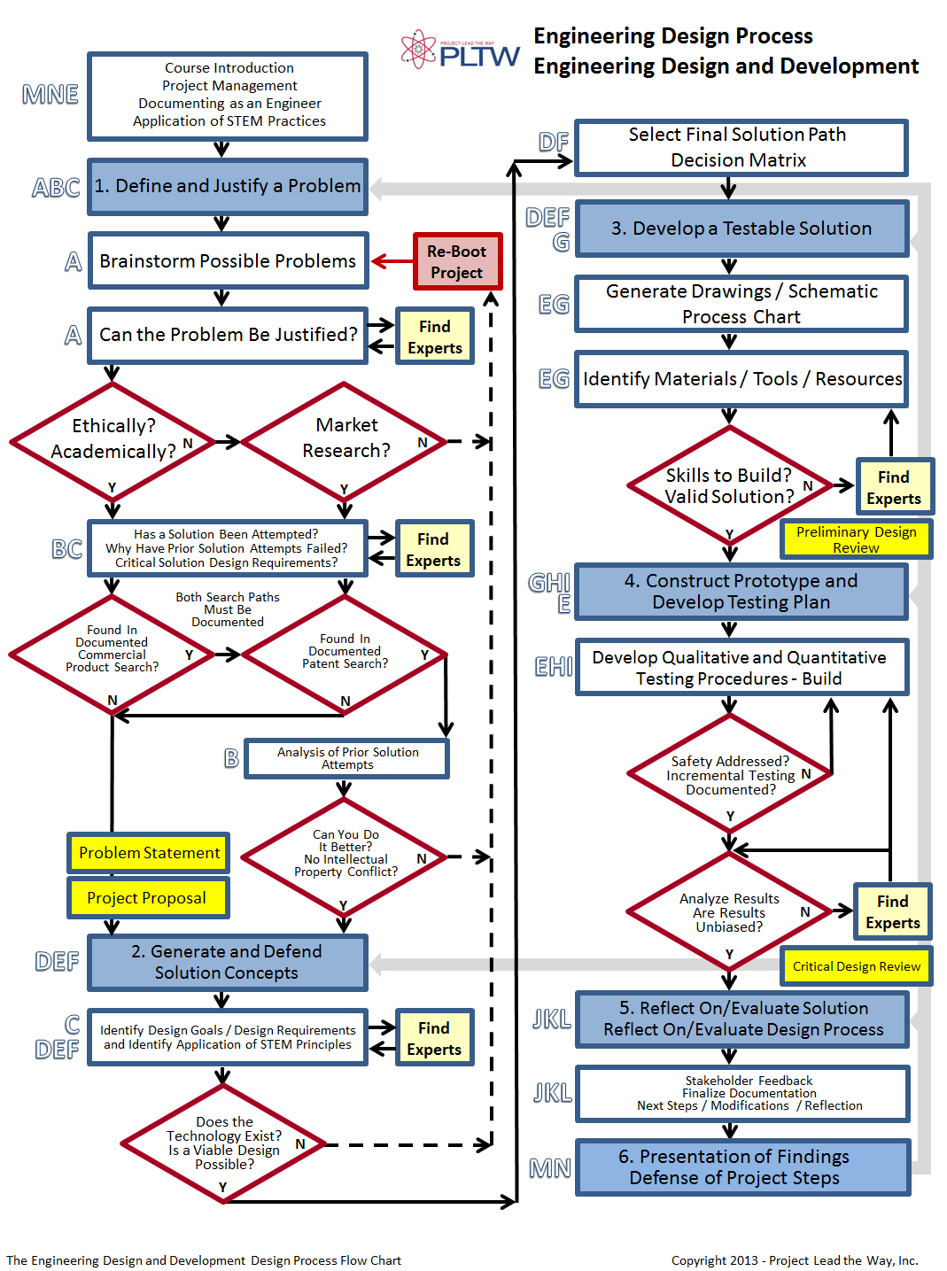
Design Process
Notes:
Let’s take a look at where we are in the product development process.
[click] Once you have several good ideas for solving your problem, it’s time to compare your alternatives. First you’ll need to list all of the alternative solutions. Based on your research, create a list of the most promising soluions to your problem.
[click] The next step is to choose a solution path by selecting the alternative that is deemed most likely to succeed, that is, the potential solution that best meets the solution criteria within the constraints.

Slide 3
Selection Process
Create a decision matrix
Rate the concepts
Rank the concepts
Combine and improve the concepts
Select top concept(s)
Reflect on the results

Slide 4
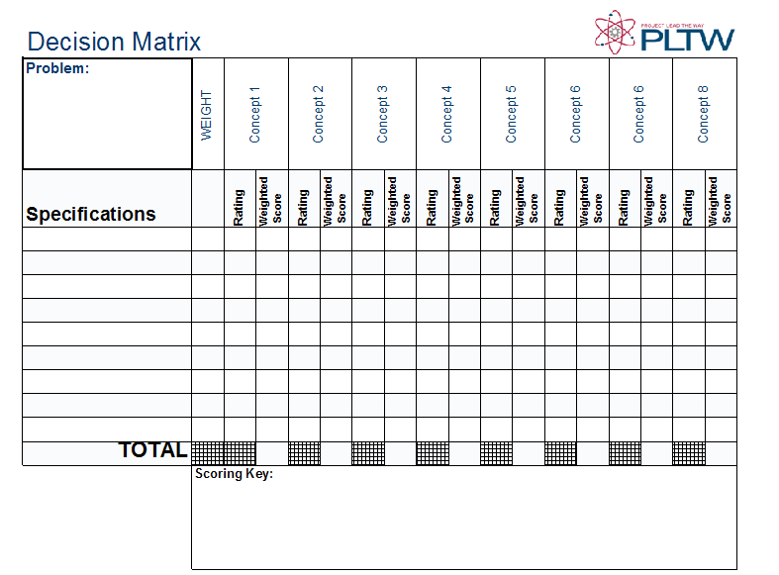
Create a Decision Matrix
7
Problem: Lessen premature death of Red Drum due to mouth infections in the lower Laguna Madre of Texas
Notes:
One common method of comparing alternate methods or solutions is completing a decision matrix. A decision matrix is a graphical tool consisting of columns and rows that is used to compare alternatives while considering a list of specifications and constraints

Slide 5
Create a Decision Matrix
7
Problem: Lessen premature death of Red Drum due to mouth infections in the lower Laguna Madre of Texas
Notes:
First indicate the problem. In most cases the statement of purpose can be used here. [click]

Slide 6
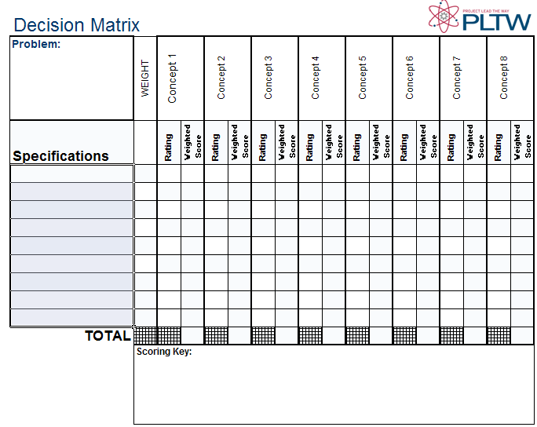
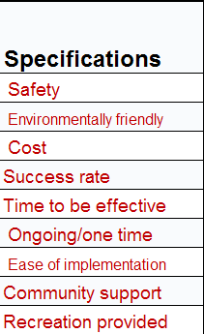
Create a Decision Matrix
Notes:
List all of the important considerations when comparing the concepts. Use the design specification to guide your choices and add other issues that you feel are important. You may want to revisit your design specification if important issues arise that were not included in the design specifications.

Slide 7
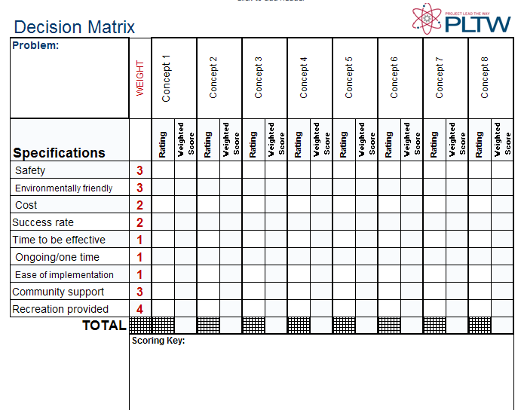
Create a Decision Matrix
Notes:
In most cases some of the specifications or requirements will be more important than others. You can assign weights to the specifications so that the more important requirements have a greater influence on the ratings.
Use numbers to express the relative importance of each specification. Assign larger numbers to the more important considerations, such as safety, and assign smaller numbers to the less important factors.
Weight the factors that are essential to a successful solution with larger numbers. Rate factors that are desirable but not essential with lower numbers. For example, a successful solution to this problem requires a safe and environmentally friendly solution that allows fishermen to continue to fish the waterways. If any of these factors are not met by the chosen solution, significant criticism (or worse) will result. These factors have been assigned a weight of 3 or 4. On the other hand, easy implementation would be nice, but it is not essential to the success of the project and has been assigned a weight of 1.
You can use any reasonable scale. In this case a scale of 1 – 4 is used. Factors weighted with a 4 will be considered four times more important in the decision than a factor weighted with a 1. Note that in this situation, the fact that fishing is not disallowed is weighted most heavily because it is the most important consideration in the decision. However, if the solution is not safe or environmentally friendly, it will not be implemented.

Slide 8
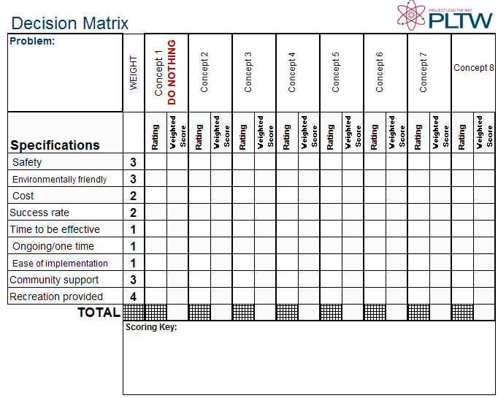
Create a Decision Matrix
The first concept is sometimes used as a baseline concept
Notes:
Next, list the concepts under consideration across the top of the matrix.
The first concept can be (but is not required to be) a baseline concept which may be an existing solution or a DO NOTHING SOLUTION. In this case the baseline concept involves doing nothing and allowing the population of Red Drum to naturally decline.
Using a baseline concept is not always appropriate, but if it is used, all other concepts are compared to a baseline solution.

Slide 9
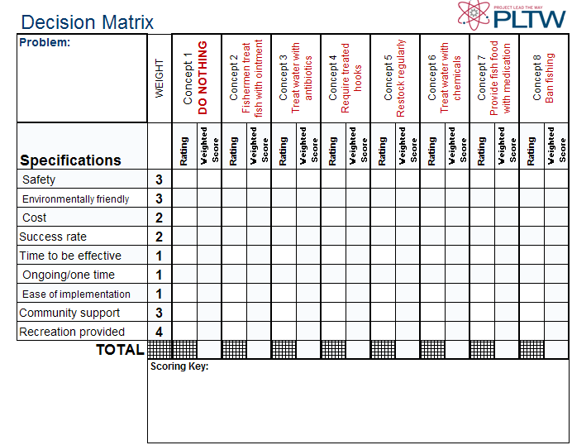
Rate the Concepts

Slide 10
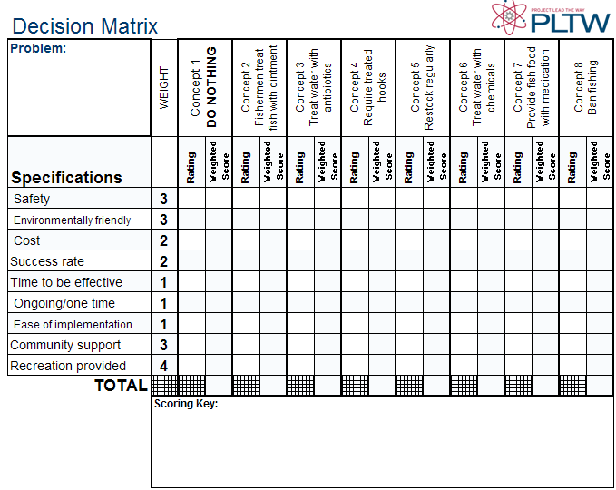
Rate the Concepts
1 Much worse than baseline
2 Worse than baseline
3 No difference from baseline
4 Better than baseline
5 Much better than baseline
Notes:
Next, create a scoring system to distinguish among the concepts. One possible system is shown in which the baseline solution is rated as a three [click] in each category, and the other concepts are rated relative to that solution.
Note that if you do not use a single baseline concept, you will not enter all threes in the first column.

Slide 11
Rate the Concepts
Alternate Rating System
+ Better than ( + scored as 1)
0 Same as (0 scored as 0)
– Worse than (– scored as -1)
Alternate Rating System
Any numeric scale (e.g., 1 – 10)
Notes:
Another scoring system that is commonly employed is using plus, zero, and minus signs. This system is often used to compare concepts as an initial step to screen a large number of concepts and reduce the number under consideration.
Any numeric scale can be used, such as 1- 10, but finer scales will require more time and effort to complete.

Slide 12
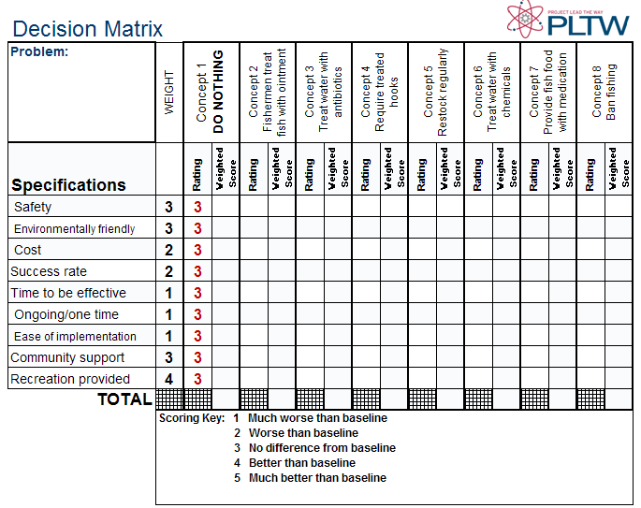
Rate the Concepts
Notes:
In this case since a baseline concept is used, we will enter threes for all of the specifications for concept 1. Note that if you do not use a single baseline concept, you will not enter all threes in the first column.

Slide 13
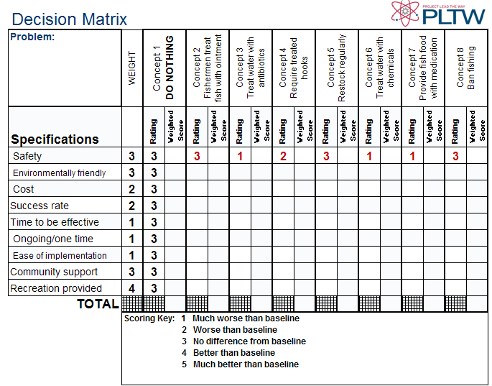
Rate the Concepts
4
Notes:
Work through the table assigning a rating to each specification for each concept. It may be more efficient to rate the concepts based on one specification at a time.

Slide 14
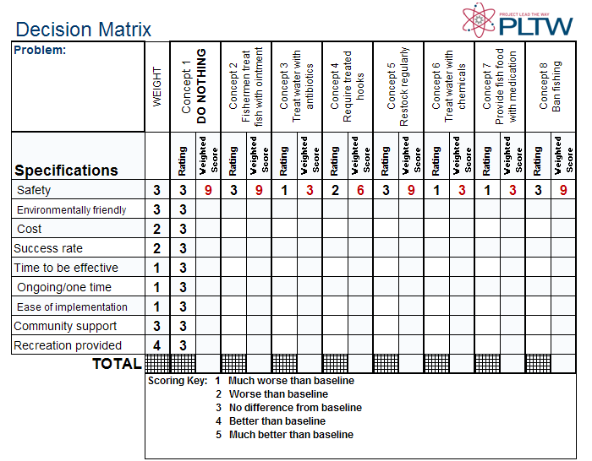
Rate the Concepts
Rating x Weight Factor = Weighted Score
4
Notes:
Be sure to calculate the weighted score by multiplying the rating by the weight factor.

Slide 15
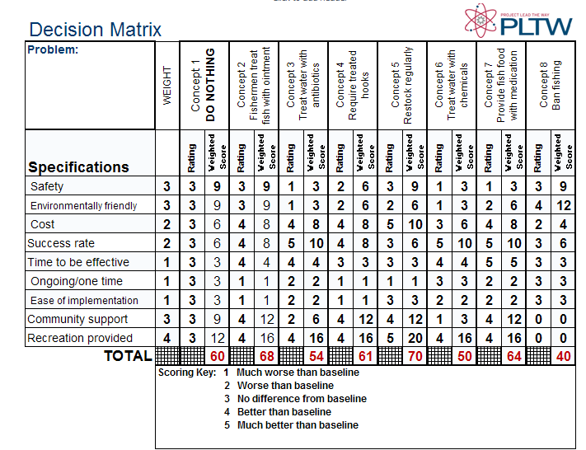
Rate the Concepts
Notes:
Once you have rated all of the concepts based on all of the specifications and weighted the scores, add up the weighted scores for each concept. The totals can then be compared to determine the better possible solutions.

Slide 16
Rank the Concepts
5
2
6
4
1
7
3
8
Notes:
Now rank the concepts. [click]

Slide 17
Rank the Concepts
Concept 5 – Restock regularly
Concept 2 – Fishermen treat fish with ointment
Concept 7 – Provide fish food with medication
Concept 4 – Require treated hooks
Concept 1 – DO NOTHING
Concept 3 – Treat water with antibiotics
Concept 6 – Treat water with chemicals
Concept 8 – Ban fishing
Notes:
Concepts 5, 2, 7, and 4 are all rated better than the baseline (DO NOTHING) option.

Slide 18
Combine and Improve
Concept 5 – Restock regularly
Concept 2 – Fishermen treat fish with ointment
Concept 7 – Provide fish food with medication
Concept 4 – Require treated hooks
Concept 1 – DO NOTHING
Concept 3 – Treat water with antibiotics
Concept 6 – Treat water with chemicals
Concept 8 – Ban fishing
Concept 9 - Stock waters with treated feeder minnows or shrimp that the Red Drum will eat
Notes:
Consider ways in which the better concepts can be combined with other concepts or improved.
Revise the concepts or add new ones based on these improvements and combinations.

Slide 19
Select One or More Concepts
Concept 5 – Restock Regularly
Concept 2 – Fishermen treat fish with ointment
Concept 7 – Provide fish food with medication
Concept 4 – Require treated hooks
Concept 1 – DO NOTHING
Concept 3 – Treat water with antibiotics
Concept 6 – Treat water with chemicals
Concept 8 – Ban fishing
Concept 9 - Stock waters with treated feeder minnows or shrimp that the Red Drum will eat
Notes:
If one concept is clearly MUCH better than the others, choose that one concept.
However, even if one is concept rated slightly higher than others, there is often more than one strong option. [click] Continue to develop the better options. Note the strong points and weak points of each remaining concept and use these observations to revise and/or add to the list of specifications.

Slide 20
Select Top Concept
7
REPEAT AS NEEDED
Notes:
Use the decision matrix tool again to continue to narrow the number of possible solutions. Repeat the process as necessary until one concept is clearly the best choice.
The decision matrix can also be used later in the design process to make decisions about subsystems or choices within the realm of the best solution.

Slide 21
Reflect on the Results
1. Think about the results of your selection process.
2. Review the ideas that have been previously discarded.
3. Consider ways to improve your current choice.
4. Do you still think your selection is the best solution?
Notes:
Although it is always possible to back up and reiterate steps in the design process, in some ways, this is a point of no return. Once you have embarked on a solution path, it becomes increasingly difficult and expensive to go back. Now is the time to take an honest and objective look at what you have done and where you are going.
Think about the results of your selection process. Review the ideas that have been discarded along the way. Consider ways to improve your current choice. Do you still believe that your final selection is the best possible solution to the problem?
If yes – Congratulations on your excellent choice.
If no – Find a better idea. Don’t continue with a bad idea just because you have brought it this far. It is much easier to change direction now than it will be once you have moved further down the design path. DON’T REGRET YOUR DECISION LATER.

Slide 22
Selection Process
Create a decision matrix
Rate the concepts
Rank the concepts
Combine and improve the concepts
Select top concept(s)
Reflect on the results

