Slide 1
Most Common Presentation Mistakes
Notes:
Push the Button!

Slide 2
Most Common PowerPoint Mistakes
Common PowerPoint Mistakes
Useable Data vs. Total Number of Slides
Effectiveness vs. Data
Font Analysis

Slide 3
Common PowerPoint Mistakes
People tend to put every word they are going to say onto their PowerPoint slides. Although this eliminates the need to memorize your talk, ultimately this makes your slides overcrowded, wordy, and boring. You will lose your audience before you even reach the bottom of your first slide.

Slide 4
Common PowerPoint Mistakes
EYE TEST
We recognize the need to keep text large.
As the text progresses down the page,
We have a desire, false sense, and belief
That it is best to keep all text together on one slide within the presentation.
Eventually, only the people in the first row can even see and read the text on the slide.

Slide 5
Common PowerPoint Mistakes
Many peple do not run spel cheek before ther presentation – BIG MISTAK!!! Nothen makes you lok les perpared than spelin erors.

Slide 6
Common PowerPoint Mistakes
4) Avoid
Excessive
Bullet-Pointing.
Only
Bullet
Key
Points.
Too
Many
Bullet-Points
And
Your
Key
Messages
Will
NOT
Stand
Out.
In fact,
The
Term
“Bullet-Point”
Comes
From
People
Firing
Guns at
Annoying
Presenters.

Slide 7
Common PowerPoint Mistakes
Bad Color Schemes
Clashing background and font colors can lead to:
  Distraction
  Confusion
  Headaches
  Nausea
  Vomiting
  Loss of Bladder Control

Slide 8
Common PowerPoint Mistakes
Excessive use of color within the presentation slides tends to confuse the audience as they try to understand the:
  Purpose
  Reason
  Scheme
  Flow
  Why you did this to me

Slide 9
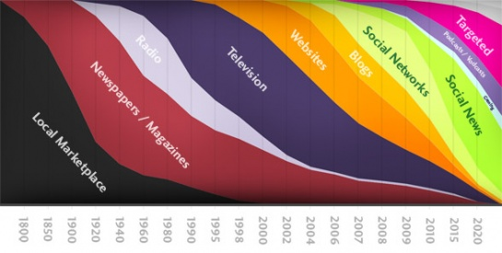
Common PowerPoint Mistakes
Inappropriate use of graphics
Notes:
Studies show that using images and text to represent your ideas is more effective than just using text. The key is choosing the right images – those same studies show that images with no purpose can actually make learning more difficult.

Slide 10
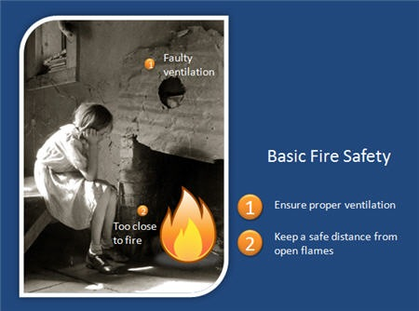
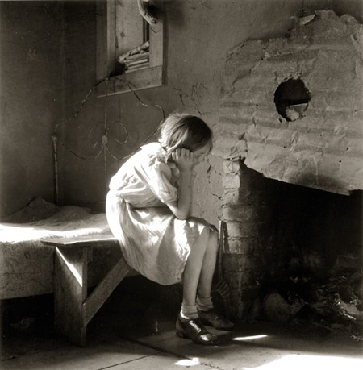
Common PowerPoint Mistakes
No explanation for why the image is relevant

Slide 11
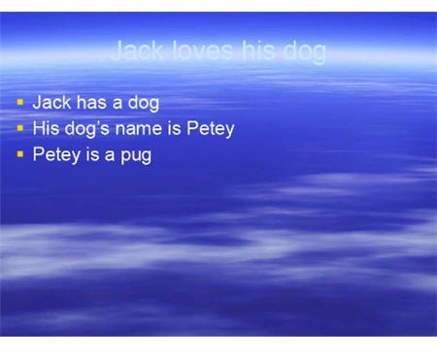
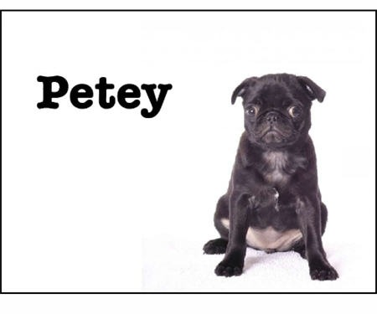
Common PowerPoint Mistakes
Use images to convey a message and to tell a story.
Using words instead of images, charts, graphs, etc.

Slide 12
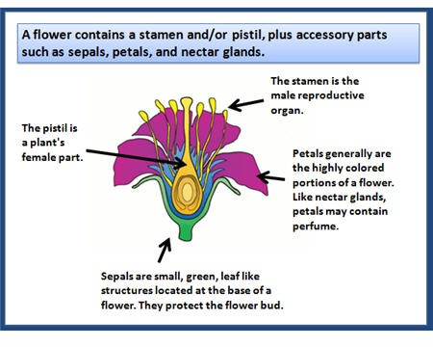
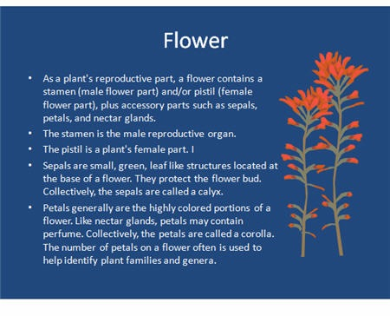
Common PowerPoint Mistakes
Images are only a decoration

Slide 13
Useable Data vs. Total Number of Slides
Effectiveness of Useable Data (High = 1)
This Presentation
X
Total Number of Slides

Slide 14
Effectiveness vs. Data
Effectiveness of Useable Data (High = 1)
98.24
88.5
91.4
87.52
84.1
91.39
76.7
82.3
85.96
76.3
76.2
71.78
71.4
71.8
71.4
69.3
Laughs (db)
48.9
41.4
Number of Slides

Slide 15
Effectiveness vs. Data
Effectiveness of Useable Data (High = 1)
98.24
88.5
91.4
91.39
87.52
76.7
82.3
84.1
85.96
71.4
76.3
71.4
76.2
71.78
71.8
69.3
Laughs (db)
48.9
41.4
Number of Slides

Slide 16
Font Analysis
Courier New
Organized and structured
Pristina
Artistic
Times New Roman
Lazy, apathetic, unimaginative
(always use the default)

Slide 17
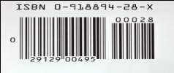
Font Analysis
Freehand Script (Freehand Script)
You are a poor speller, so you hide it with a hard to read font.
Wingdings (Wingdings)
You’re a nerd and have no
Barcode ( )
You’re a machine and did not even know it.

Slide 18
Most Common PowerPoint Mistakes
Common PowerPoint Mistakes
Useable Data vs. Total Number of Slides
Effectiveness vs. Data
Animation vs. Effectiveness
Font Analysis

Slide 19
Resources
Microsoft, Inc. (n.d.). Clip art. Retrieved from http://office.microsoft.com/en-us/clipart/default.aspx
French, D. (n.d.) Most common PowerPoint mistakes.

