Slide 1
Teamwork

Slide 2

Teamwork
What Is a Team?
What are the Benefits of a Team
Stages of Team Development

Slide 3
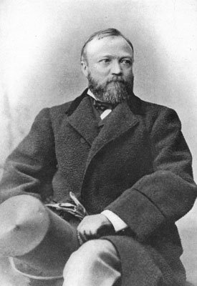
Teamwork
Teamwork is the ability to work together toward a common vision. The ability to direct individual accomplishments toward organizational objectives. It is the fuel that allows common people to attain uncommon results.
  - Andrew Carnegie

Slide 4

Why work in Teams?
Teamwork
A team is a collection of individuals, each with his/her own expertise, brought together to benefit a common goal
The more perspectives, the better the design result
Shared workload
Chances for leadership and personal satisfaction
A sense of belonging to a successful process
The ability to accomplish more than if work is performed independently

Slide 5
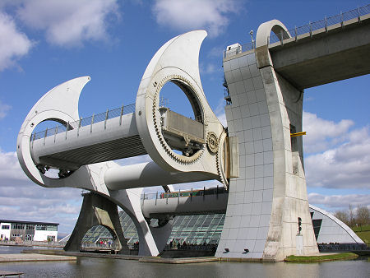
Why work in Teams?
Teamwork
Almost any project you work on will require groups of professionals with different skill sets working together.
Most jobs today are to big for one person to tackle alone.
Notes:
Falkirk Wheel

Slide 6
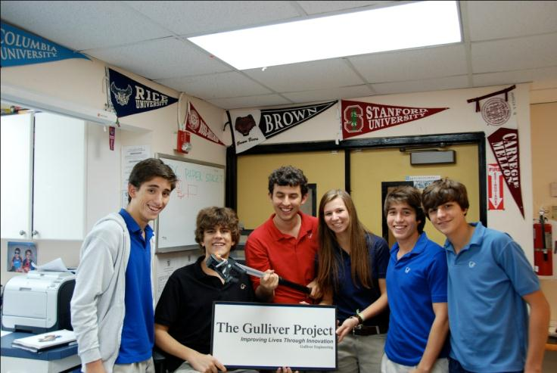
Four Phases of Teams
Stages of Team Development
Bruce Tuckerman proposed a model of group development in 1965. It is still widely used today.
The four phases Tuckerman identifies are; Forming, Storming, Norming, and Performing. He later added the Adjourning phase jointly with Mary Ann Jensen.
FORM
NORM
STORM
REFORM

Slide 7

Forming Teams
FORM
Team members share information
  Identify strengths and weaknesses of the team
  List individual talents, skills, and limitations
  Share experiences and background
  Remember that each team member’s strengths are a support mechanism for the weaknesses of other team members
Identify the team’s mission
  What does the team have to do?
  How will the team accomplish the task?
  What information is needed?
  What resources are available?
©iStockphoto.com
Notes:
Falkirk Wheel

Slide 8

Establishing Team Norms
NORM
Create the rules to guide your team
  Brainstorm a list of norms with teammates.
  Analyze each norm and discuss its impact on the team and the overall goal.
  Identify key norms that everyone can come to consensus on.
  Commit to follow these rules.
  Establish consequences if norms are broken.
Typical Group Norms
  Input from all team members required
  Access to all files
  Meet schedule and project deadlines
  Communication protocols
  Conflict resolution protocols
A copy of the established norms should be provided to each team member.
Notes:
Falkirk Wheel

Slide 9
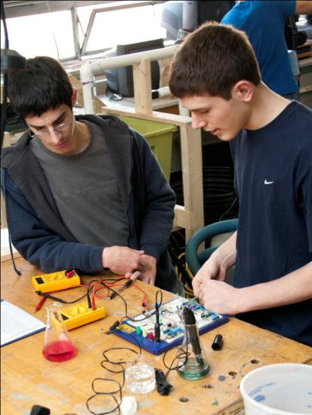
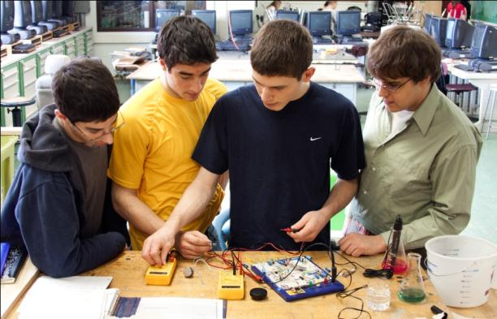
Storming the Problem
STORM
Learn how to work together
Settle into roles and share responsibility
Be wary of competition among team members
Be prepared for difference of opinions
Get the job done.
Notes:
The Storming stage is marked by conflict among team members and is inevitable within a successful team. Team members compete for status and argue for their ideas. There are different opinions on what the team should do and how the team should proceed. Eventually a successful team will learn how to work together and share responsibility.
Listening to others and respecting other peoples’ ideas are essential skills that all team members should strive to master in order to move through the Storming stage and facilitate the success of the team.
Because the input of all team members is valuable, often more aggressive team members must learn to allow others to share their thoughts. Additionally, more timid team members must learn to be more assertive.
If a team becomes locked in conflict and does not move past this stage, the team will suffer from low motivation and may find it difficult to successfully accomplish the team goals.

Slide 10

What is working? What is not?
REFORM
As you work through the project, things will not go as planned.
Revisit you team norms and evaluate what is important. Did the need for a new norm present itself?
What would you have done differently?
Notes:
Falkirk Wheel

Slide 11
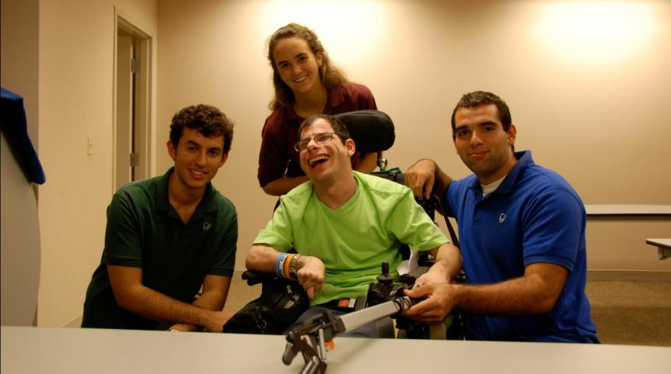
Acknowledge Your Teams Work
ADJOURN
A good practice is to have a final meeting to acknowledge the work completed and establish further steps.
You want to walk away from a project with a sense of completion, not with a sense of unfinished work.

Slide 12
Image resources
Microsoft, Inc. (n.d.). Clip art. Retrieved September 30, 2009, from http://office.microsoft.com/en-us/clipart/default.aspx iStockphoto. Retrieved October 27, 2009, from http://www.istockphoto.com/index.php

