Slide 1
Writing a Design Brief

Slide 2
Writing a Design Brief
Design briefs are written to help the designer design their solutions and to ensure that their designs actually solve the problem that they are looking to solve.
They are written in the “Finding the Problem” stage of the design process.

Slide 3
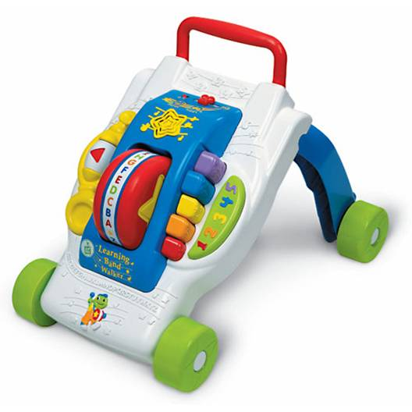
Parts of the design brief
Assume that we are writing a design brief that ultimately became this design:

Slide 4
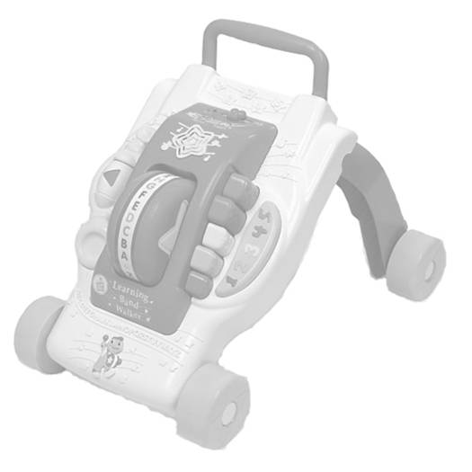
Parts of the design brief
The 4 main parts of the design brief are:
Client / End User / Target Consumer
Problem Statement
Design Statement
Criteria & Constraints

Slide 5
Who might the Client be?
A large toy manufacturer, such as Playskool™, Fisher Price™, Leap Frog™, etc.
Who was the Target Consumer?
Obviously, a child is the end user, but a person (parent, family member, or family friend) considering the purchase of an educational toy for an infant or toddler would be the target consumer.

Slide 6
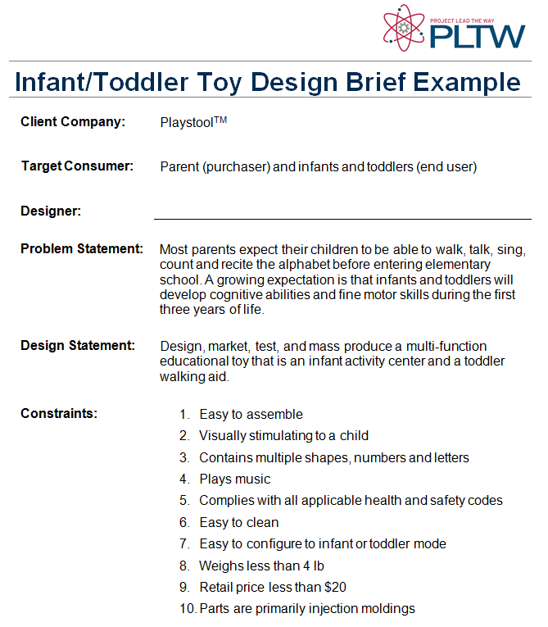
The Client

Slide 7
Target Consumer
Note:
The clients, end-users, target consumers are often known as the stakeholders.
Sometimes the target consumer and the client are one in the same.

Slide 8

Parts of the design brief
Client / End User / Target Consumer
Problem Statement
Design Statement
Criteria & Constraints

Slide 9
What was the Problem Statement?
The problem statement is a clear and concise identification and description of the design problem or opportunity.
A clear description of the problem allows you to focus your efforts and avoid wasting time working on a design that does not address the issue at hand.

Slide 10
What was the Problem Statement?
A good problem statement leaves room for multiple solutions so it doesn’t imply a solution.
It also answers the following questions:
Who has the problem?
What exactly is the problem?
Where does the problem exist?
When has it happened and for how long?
How prevalent is the problem (statistics)?
Who says there is a problem?

Slide 11
What was the Problem Statement?
Most parents expect their children to be able to walk, talk, sing, count and recite the alphabet before entering elementary school. A growing expectation is that infants and toddlers will develop cognitive abilities and fine motor skills during the first three years of life.

Slide 12
Problem Statement

Slide 13
Question #4:
What might the design brief look like?
Client / End User / Target Consumer
Problem Statement
Design Statement
Criteria & Constraints

Slide 14

What was the Design Statement?
A design statement describes the anticipated solution to address the needs of stakeholders and the problem statement.
What exactly will you do and provide as part of your solution?

Slide 15
What was the Design Statement?
Design, market, test, and mass produce a multi-function educational toy that is an infant activity center and a toddler walking aid.

Slide 16
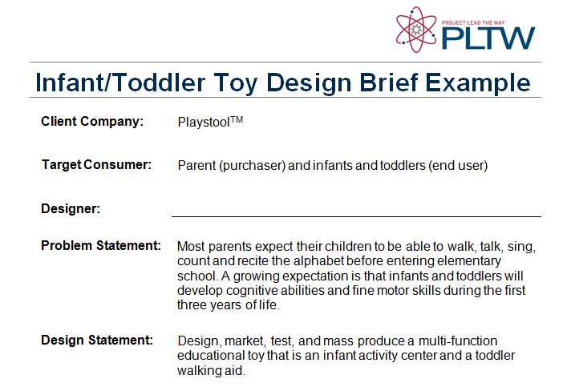
Design Statement

Slide 17
Question #4:
Client / End User / Target Consumer
Problem Statement
Design Statement
Criteria & Constraints

Slide 18
What might the Criteria & Constraints have been?
The criteria is a list of specific, concise measurable requirements that describe what the solution must do to meet the needs of stakeholders and be successful.
Constraints are the limits on the design and production of a product, expressed with specific, measurable values. These might include time, budget, codes, safety, or physical attributes (size, weight, color).

Slide 19
What might the Criteria & Constraints have been?
Easy to assemble
Visually stimulating to a child
Contains multiple shapes, numbers and letters
Plays music
Complies with all applicable health and safety codes
Easy to clean

Slide 20
What might the Criteria & Constraints have been?
Easy to configure to infant or toddler mode
Weighs less than 4 lb
Retail price less than $20
Parts are primarily injection moldings

Slide 21
Criteria & Constraints

Slide 22

Question #4:
What might the design brief have looked like for this design?

Slide 23
Question #4:
What might the design brief look like?
Client / End User / Target Consumer
Problem Statement
Design Statement
Criteria & Constraints

