Slide 1
Isometric Sketching

Slide 2
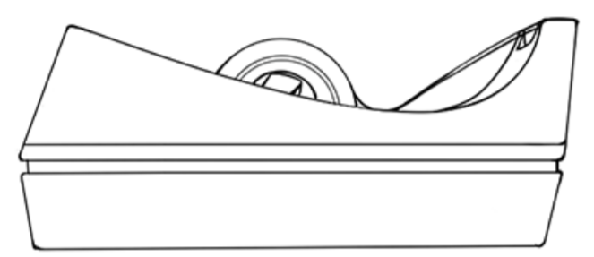
Pictorial Drawing
Orthographic drawings show only one view of the object
3D object on a 2D plane
Shading is the only thing that makes it look “3D”
Notes:
2

Slide 3
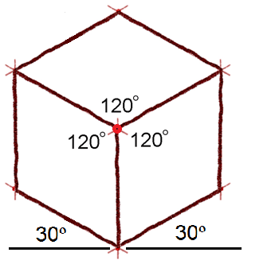
Isometric Sketch Characteristics
Sketch appears three-dimensional because three sides are shown.
All principal dimensions (width, depth, and height) are represented in true proportion.
Width and depth lines are drawn
at 30 degrees from horizontal.
All height lines are vertical.
The shapes of the object faces
are distorted (not represented
as true shapes).
Notes:
3

Slide 4
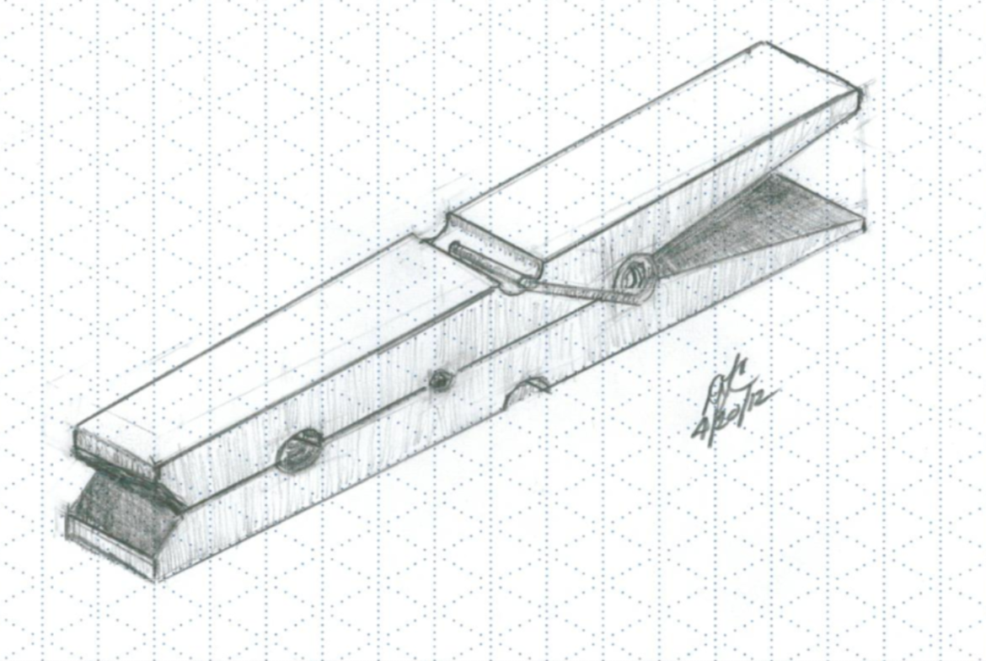
Isometric Sketch Characteristics
How is isometric graphing paper different from that of the orthographic kind?
Notes:
4

Slide 5
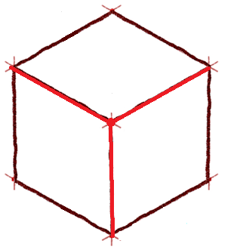
Where is the height, width, depth?
Where is the front view,
side view, and the
top view?

Slide 6
Isometric Pictorial
These three edges represent height, width, and depth
width
depth
height
Notes:
6

Slide 7
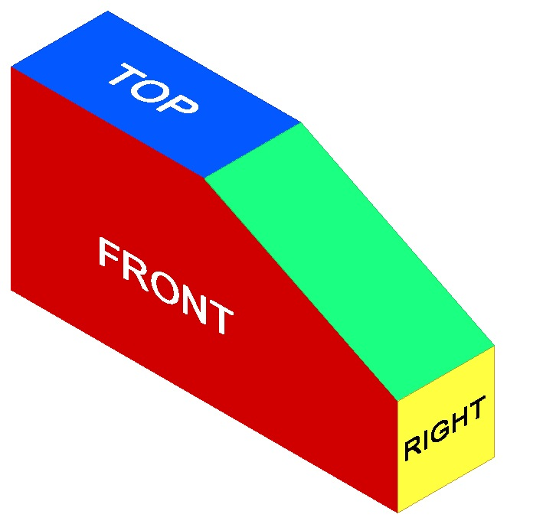
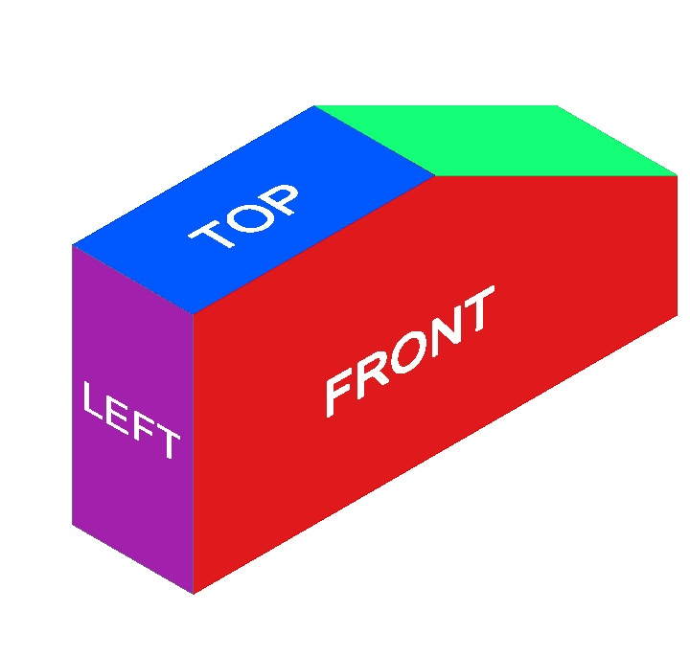
View labels
Top, Front, Right Side view orientation
Top, Left Side, Front, view orientation
Notes:
Isometric views can be presented in two different view orientations. We will use the Top, Front, Right Side view orientation exclusively in IED.

Slide 8
View Selection
Recommendations for how to select the front view
  Most natural position or use
  Shows best shape and characteristic contours
  Longest dimensions
  Fewest hidden lines
  Most stable and natural position
Notes:
The view of the side that provides the most information about the object is generally chosen as the FRONT view. Finding the best front view of a part can be difficult. Two or more sides may look like the best solution for a front view.
When selecting a front view, compare all side views and choose a front view based on the list of criteria in this list.

Slide 9
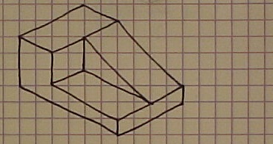
Orthographic View Selection
No hidden edges
Best shape
Description
BEST FRONT VIEW
Most natural position
Longest Dimension
Notes:
We will use the Top, Right Front view orientation. So the view that is chosen as the front view should be drawn facing to the left-front in an isometric view as shown here.

Slide 10
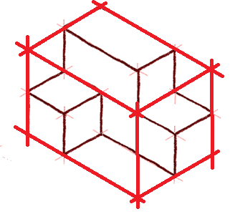
The Box Method
The box method is a sketching technique used to maintain proportionality
It starts with a sketcher envisioning an object contained within an imaginary box
Notes:
10

Slide 11
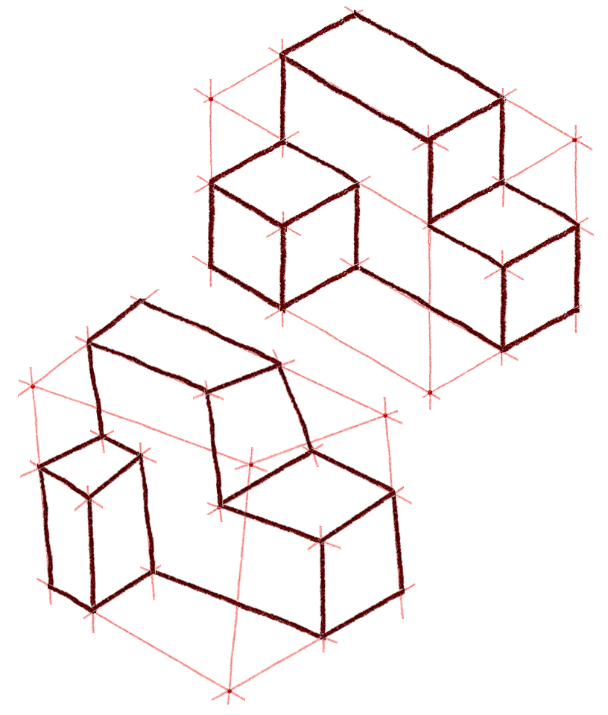
Proportion and Estimation
What the problems with the bottom drawing?
Notes:
Good sketching requires a sense of proportion, and the ability to estimate size, distance, angles, and other spatial relationships
11

Slide 12
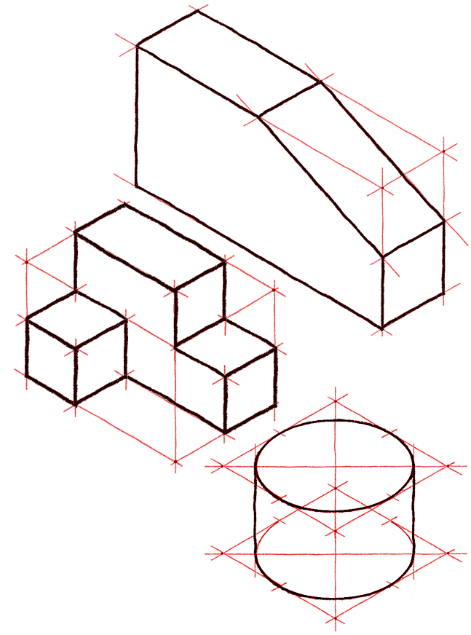
Isometric Sketching
What is the difference between the red lines and the black lines?
Let’s draw the following objects together
Notes:
12

Slide 13
Steps to remember
Determine and draw the “glass” box.
Draw the object faces that touch the outside of the glass box.
Draw the interior faces.
Notes:
Imagine a glass box surround your object, what would the largest dimensions have to be?

Slide 14

EXAMPLE 1
Isometric Sketch
Notes:
14

Slide 15
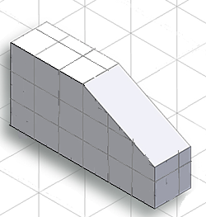
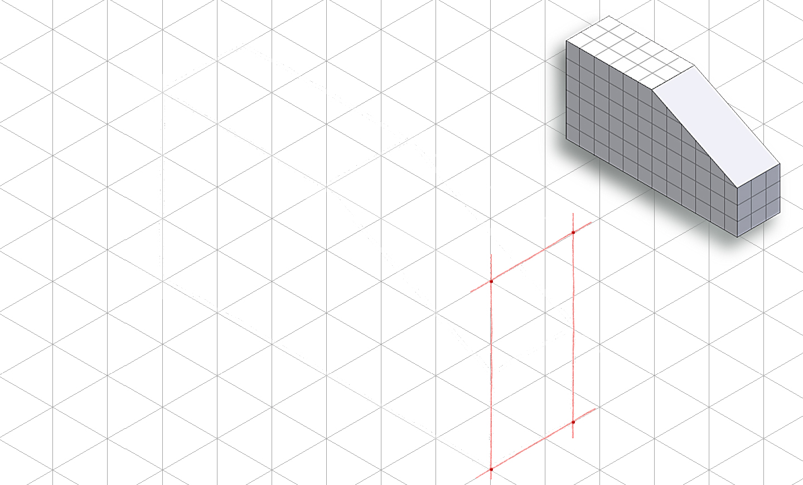
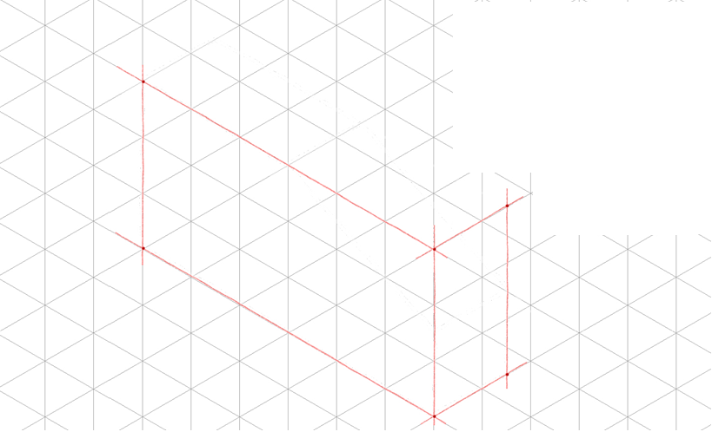
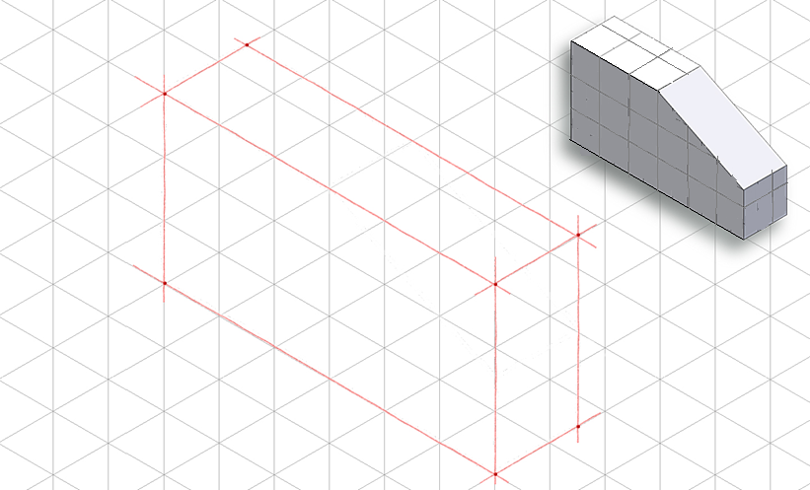
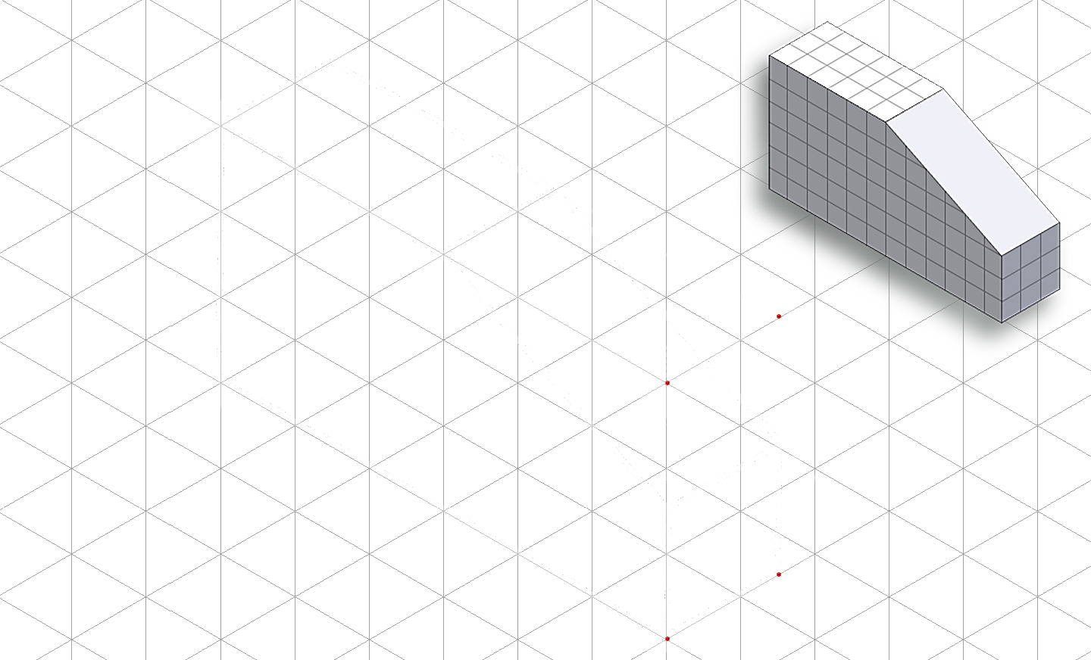
Step 1: Construct the Box
Layout the box that will contain the isometric view using points and construction lines
Notes:
Stress the importance of light construction lines when constructing the box and connecting the points.

Slide 16
Step 1: Construct the Box
Layout the box that will contain the isometric view using points and construction lines
Notes:
Stress the importance of light construction lines when constructing the box and connecting the points.

Slide 17


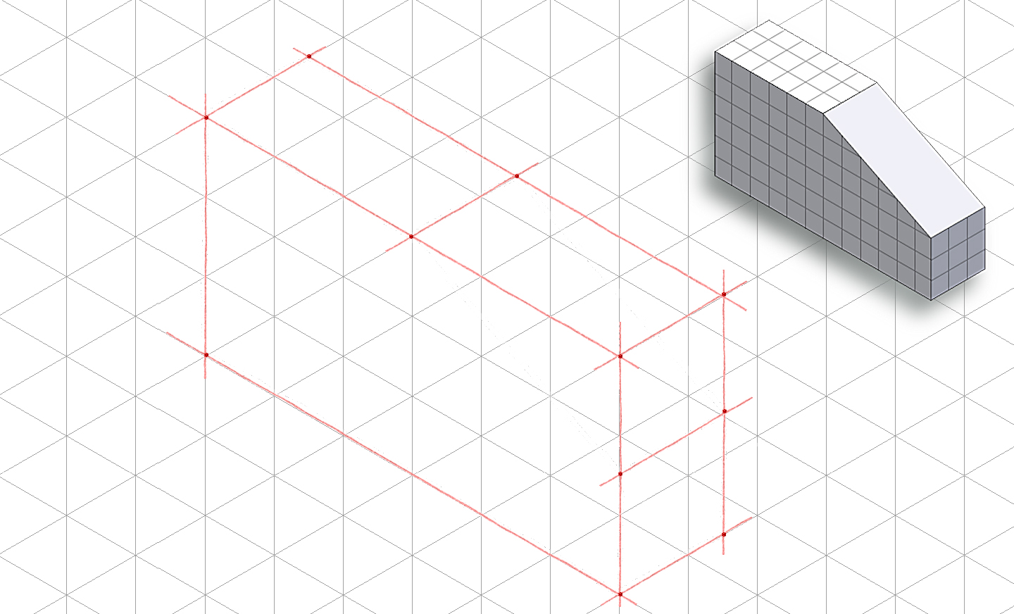
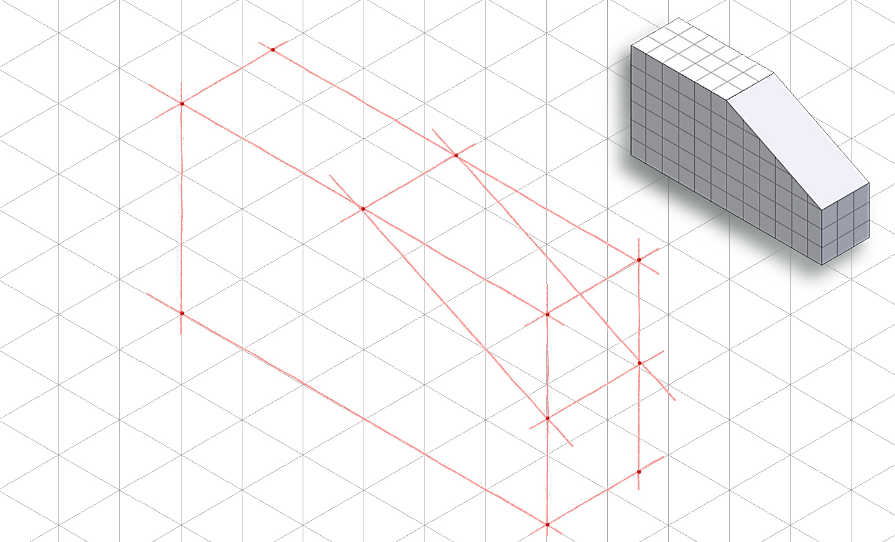
Step 2: Outside Faces
Use points and construction lines to identify corners and edges of object faces that occur on box surface
Notes:
17

Slide 18
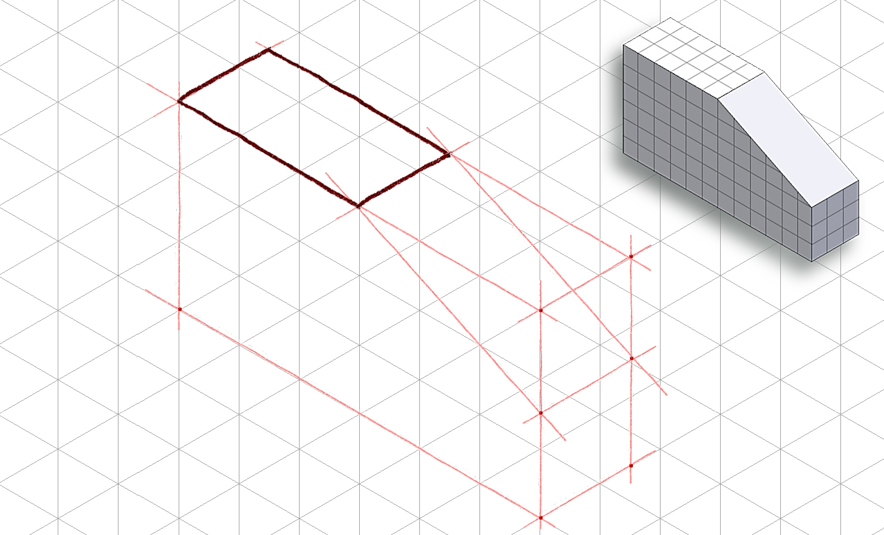
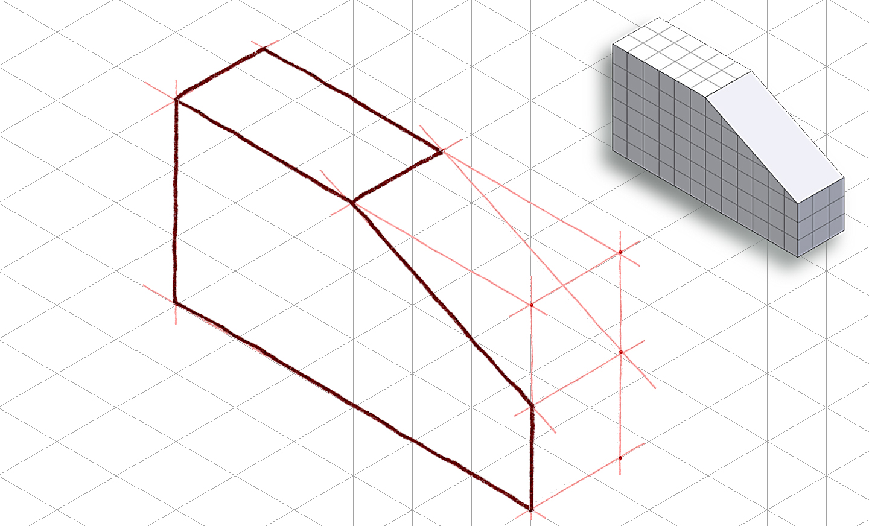

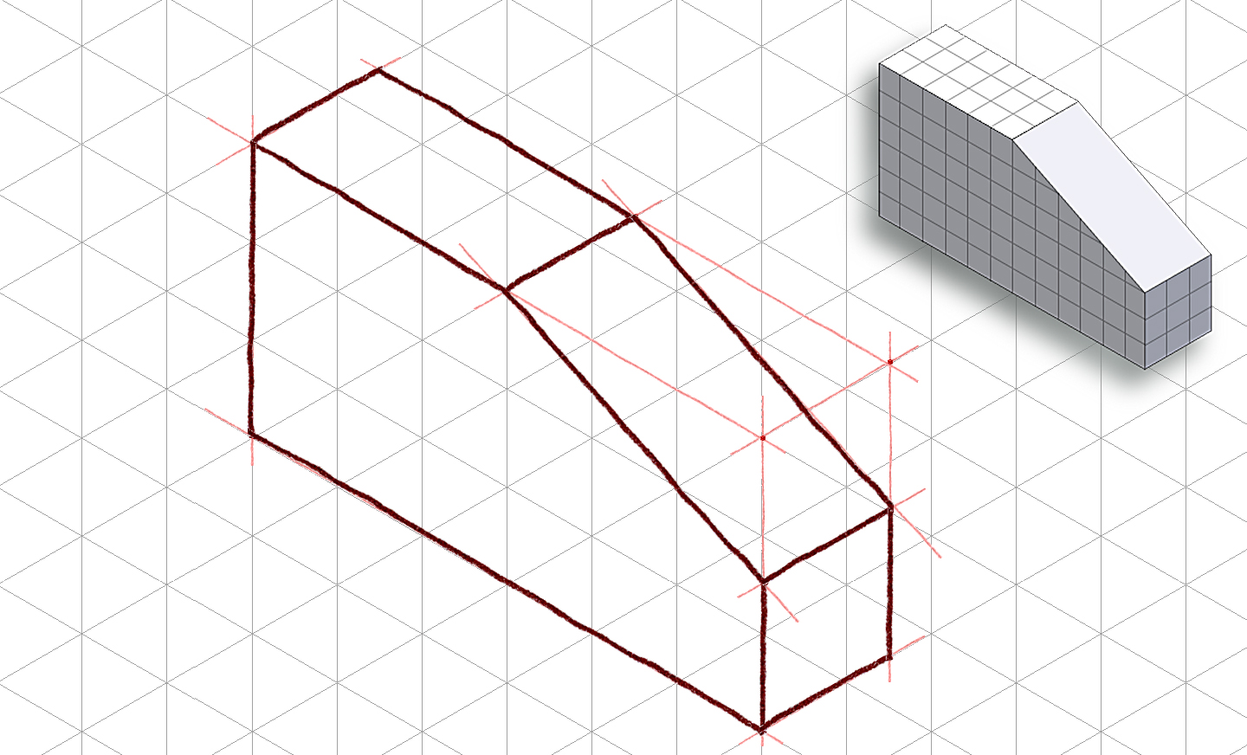
Step 2: Outside Faces (continued)
Trace visible edges of part with thick, dark object lines
Notes:
18

Slide 19
Step 3: Inside Faces
In this case, there are no inside faces
Notes:
You’ll see an example of an isometric sketch with inside faces soon.
19

Slide 20
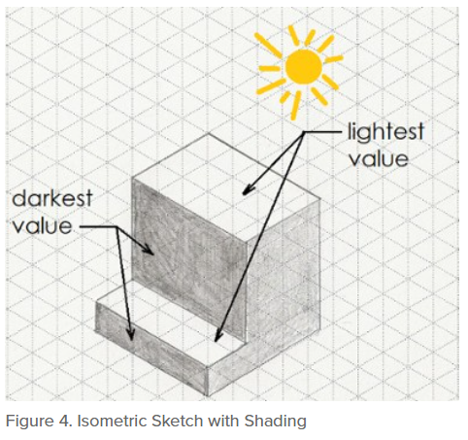
Step 4 - Tonal Shading
Decide the light source position, and add tonal shading to two of the three faces
A shading option is to use parallel lines drawn closely together on a face
Increase contrast by cross-hatching lines on darkest face
Notes:
Tonal shading is a technique that helps enhance the sketch and create a more realistic representation. It imitates reflections and shadows that would naturally occur when a direct light source is introduced.

Slide 21
EXAMPLE 2
Isometric Sketch
Notes:
21

Slide 22
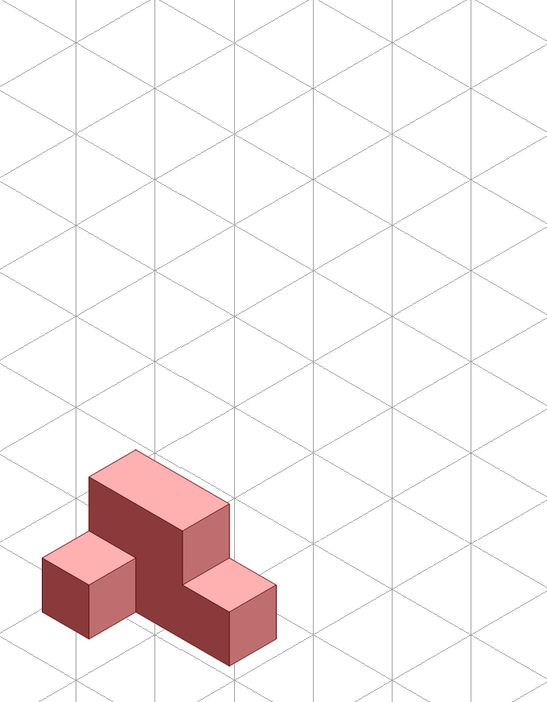
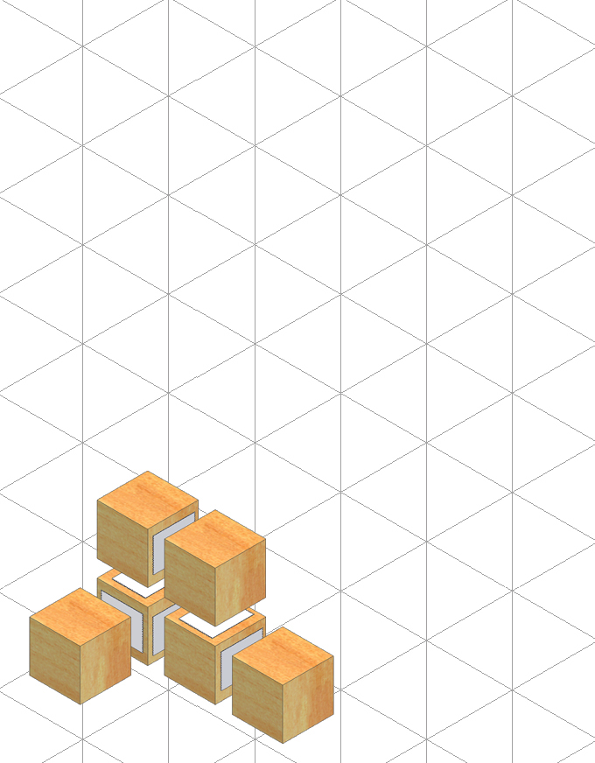






Step 1: Constructing The Box
Determine the overall dimensions of the object:
3 units wide
2 units tall
2 units deep
Use points and construction lines to layout the box.
Notes:
Again light construction lines.
22

Slide 23






Step 2: Outside Faces
Use points and construction lines to identify corners and edges of object faces that occur on surface of the box
Notes:
23

Slide 24
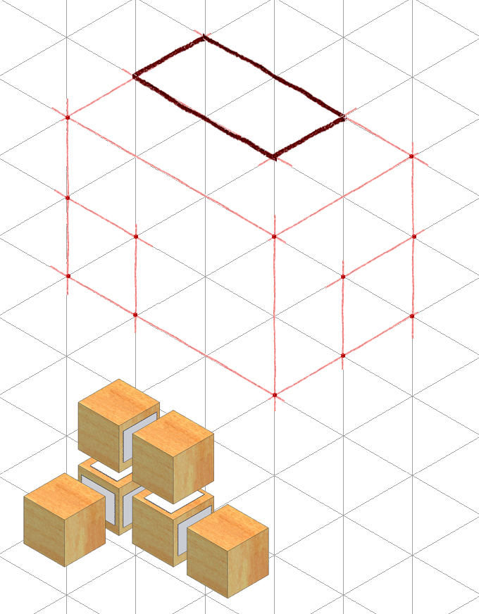
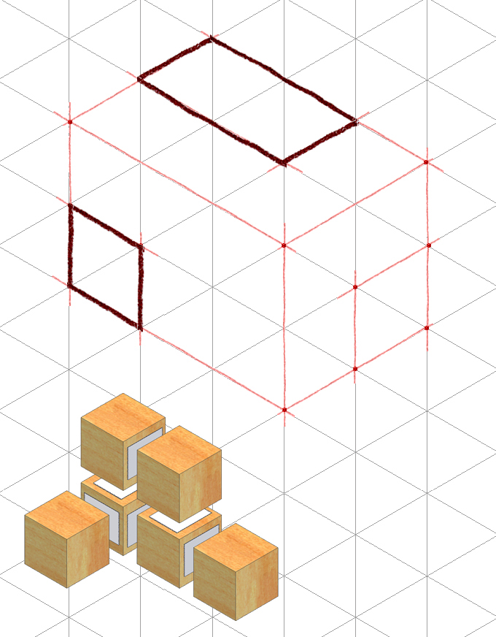
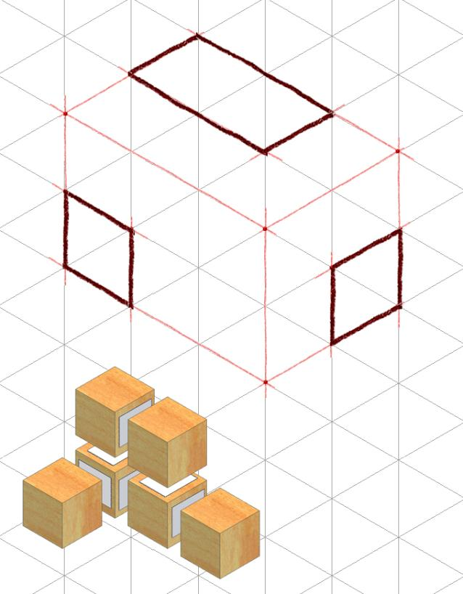
Step 2 – Outside Faces (continued)
Before sketch becomes too congested with construction lines, trace visible edges with object lines
Notes:
24

Slide 25




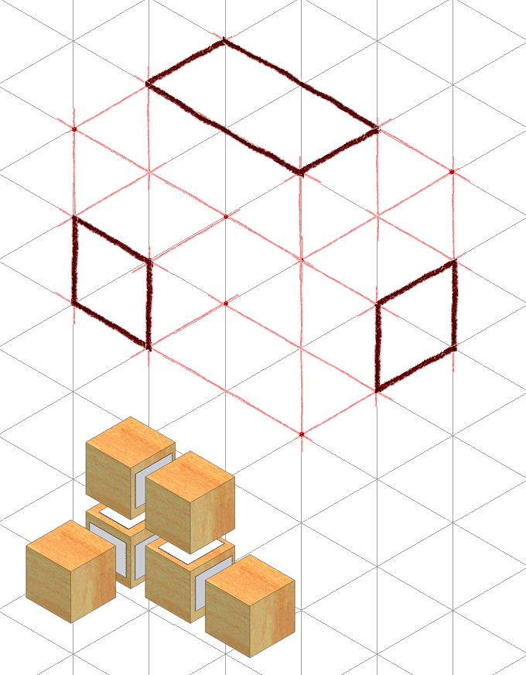

Step 3 - Inside Faces
Use points and construction lines to identify the corners and edges of the object faces that occur inside the box.
Notes:
25

Slide 26

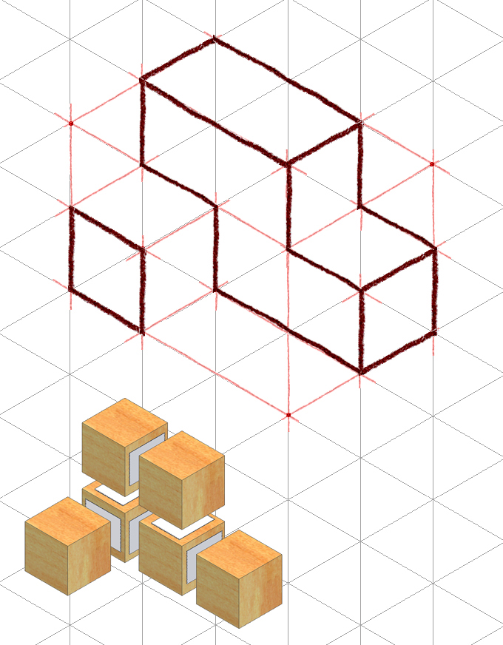
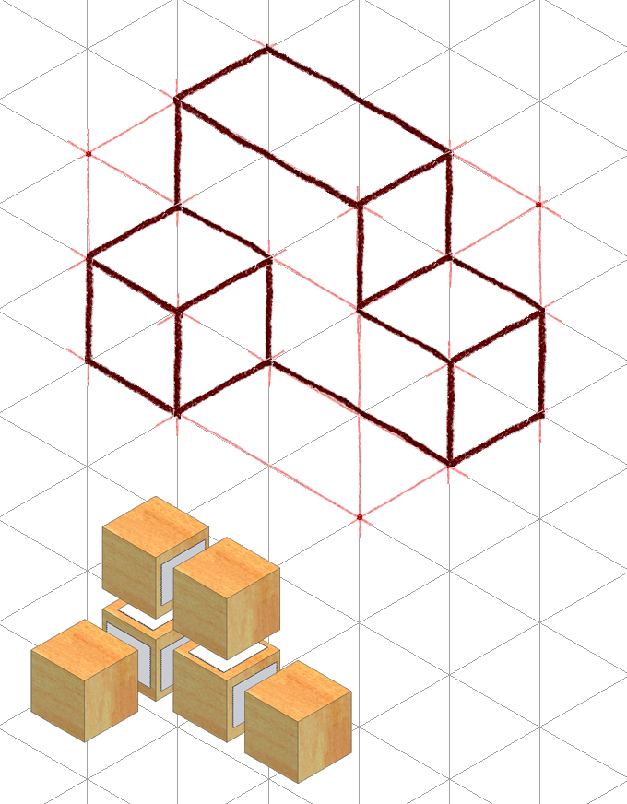
Step 3 - Inside Faces (continued)
Trace out remaining visible edges with object lines
Notes:
26

Slide 27

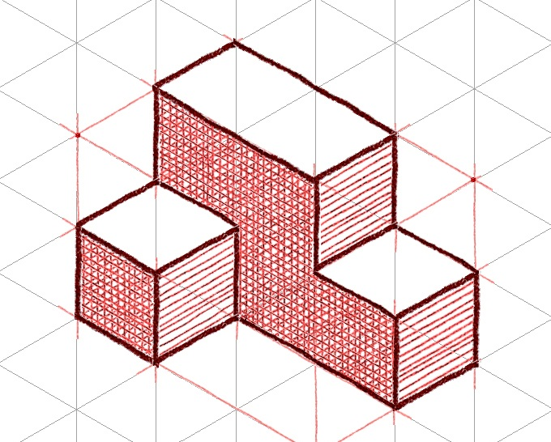
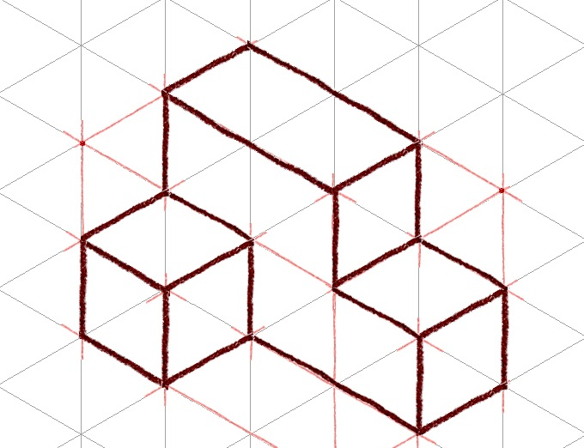
Step 4 - Tonal Shading
Decide the light source position, and add tonal shading to two of the three faces
A shading option is to use parallel lines drawn closely together on a face
Increase contrast by cross-hatching lines on darkest face
Notes:
Again, tonal shading is a technique that helps enhance the sketch and create a more realistic representation. It imitates reflections and shadows that would naturally occur when a direct light source is introduced.

Slide 28
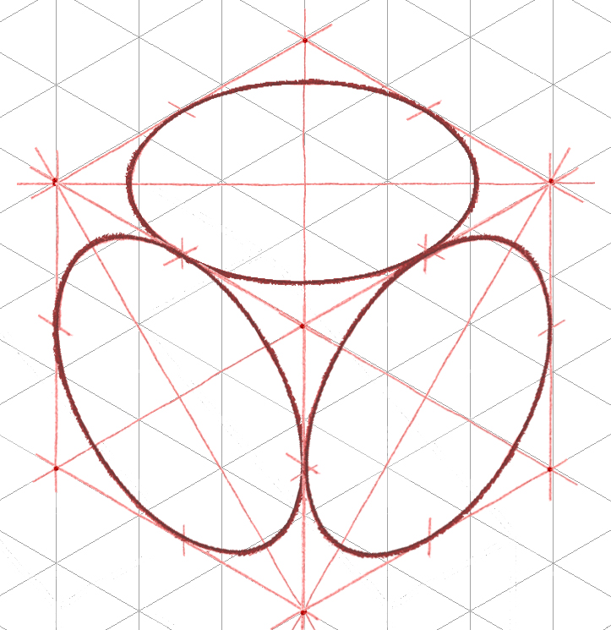
Sketching an Isometric Circle
Circular features and cylindrical forms are common in engineering designs, and appear as ellipses in isometric pictorials.

Slide 29
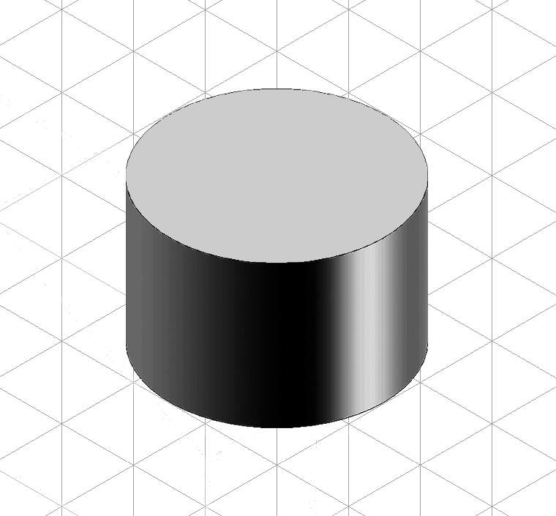
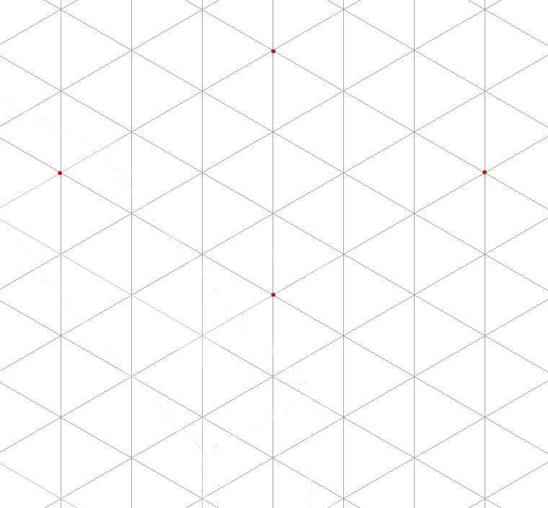
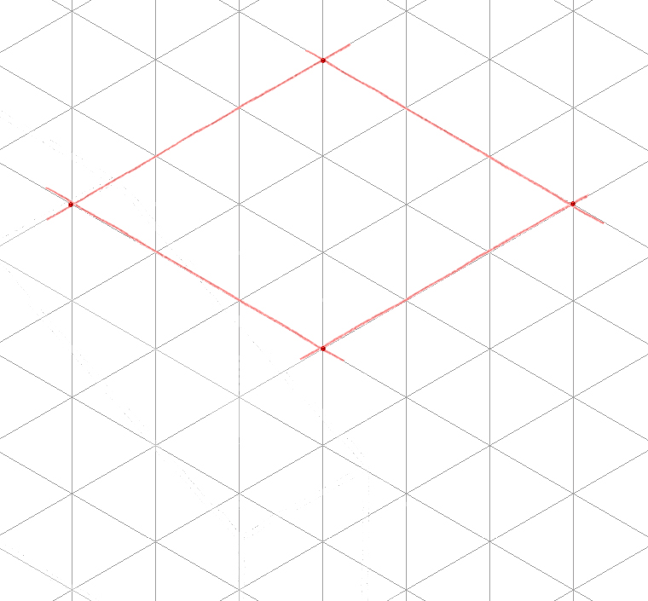
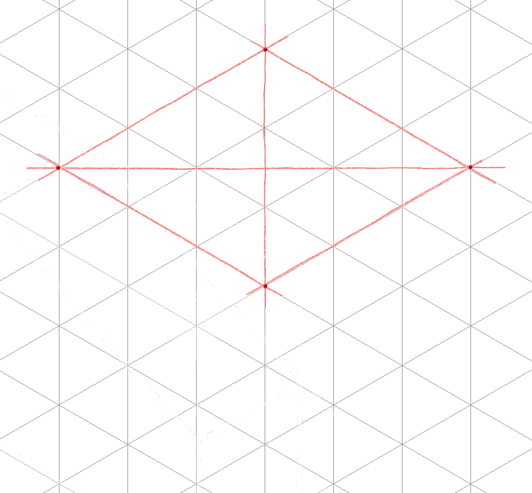
Sketching an Isometric Circle
Use points and construction lines to box in the location where the cylinder’s circular face occurs.
Next, connect the four corners with diagonal construction lines.

Slide 30
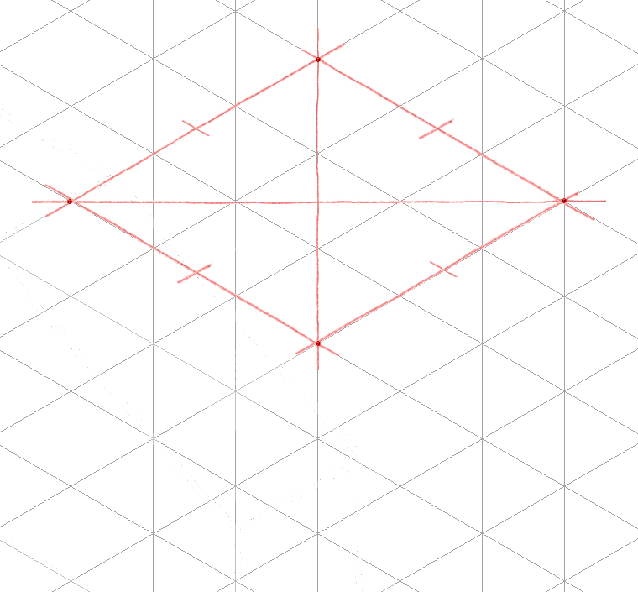
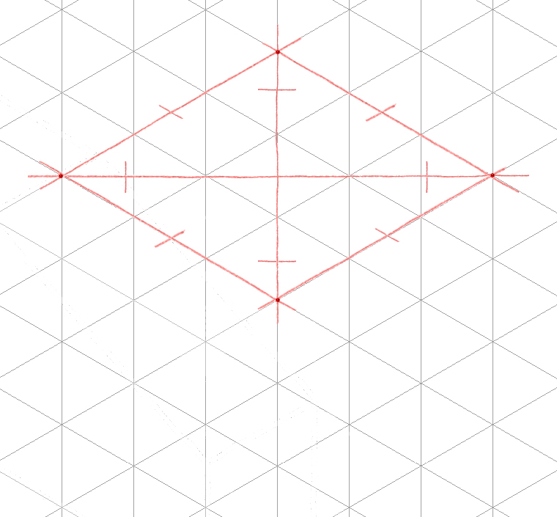
Sketching Isometric Circles
Tangent points are identified by placing marks at the mid-point locations along the four outside edges, and ⅔ of the distance from the box center to each outside corner on the four diagonals.

Slide 31
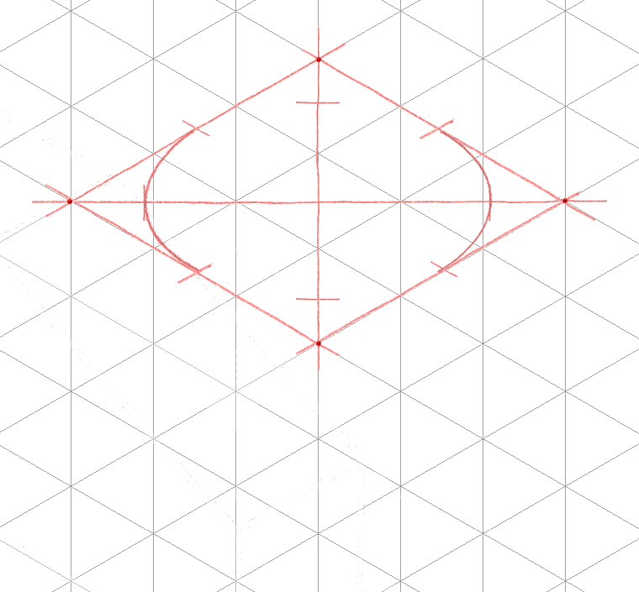
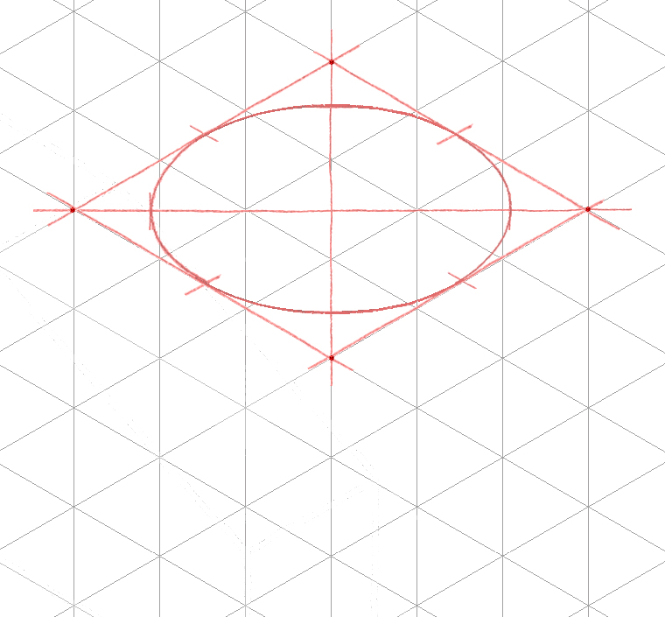
Sketching Isometric Circles
Four individual construction line arc segments are then drawn tangent to the marks that were created in the previous step.

Slide 32
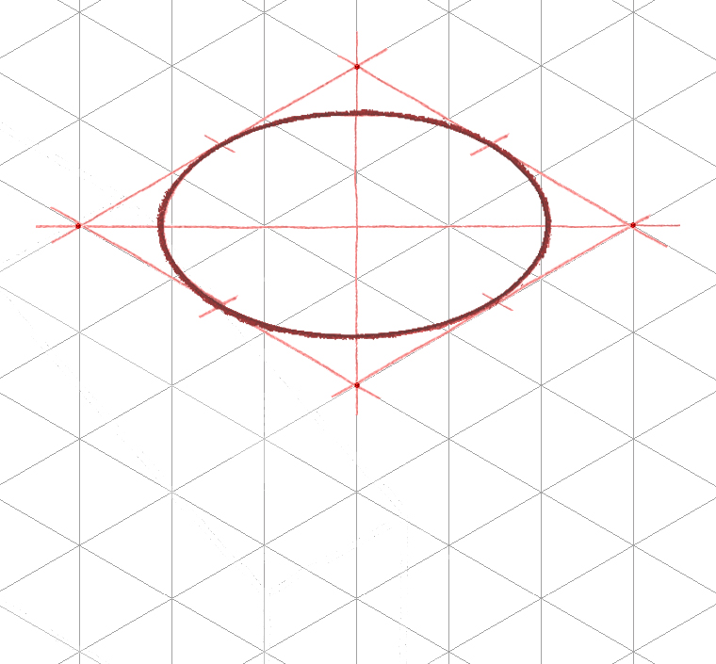
Sketching Isometric Circles
The construction line ellipse is then traced over with an object line.

Slide 33

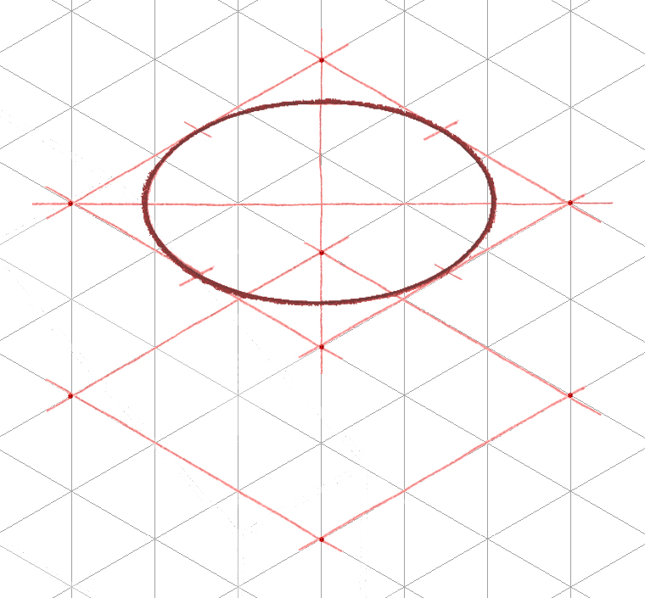
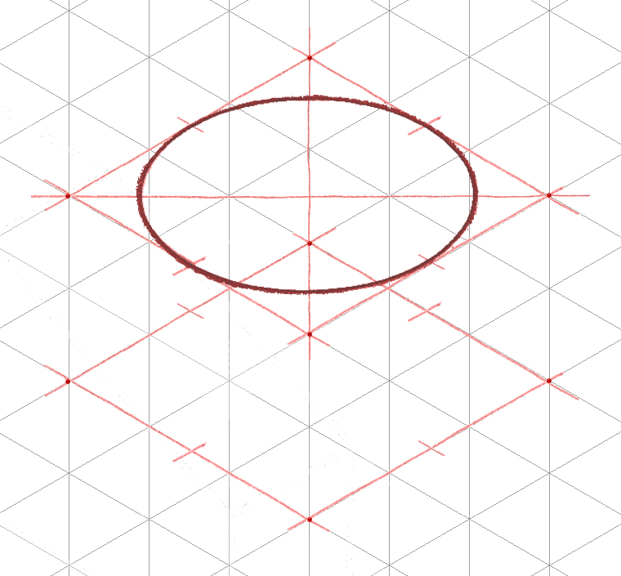
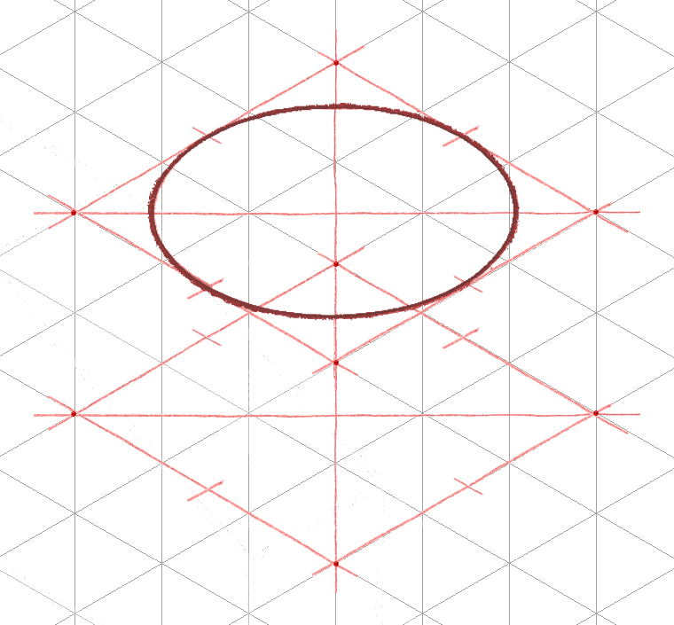

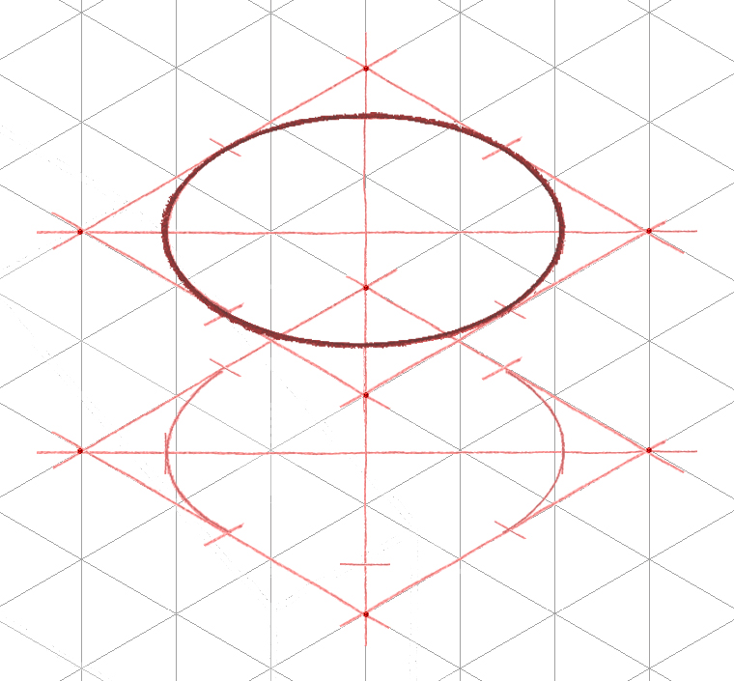
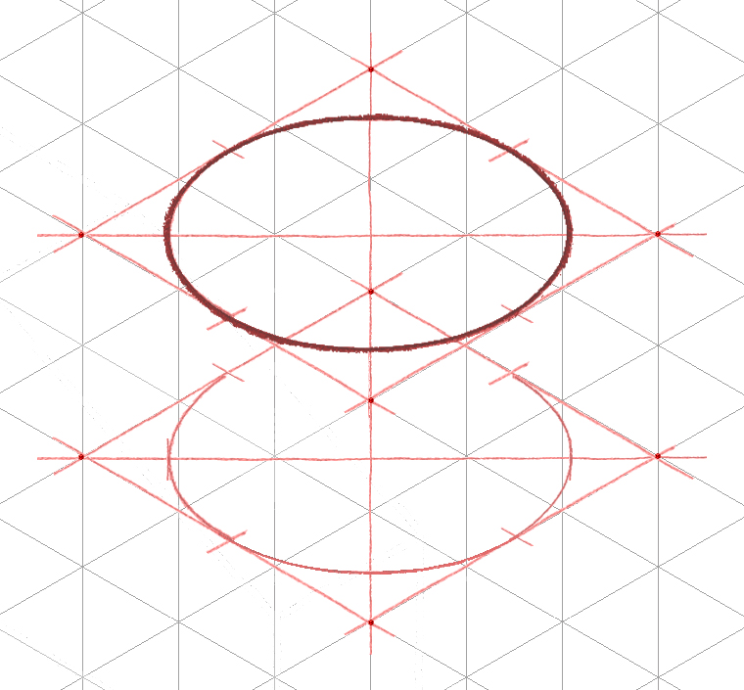
Sketching Isometric Circles
The process is repeated where the other end of the cylinder occurs.
It should be noted that only part of the second ellipse will be visible.

Slide 34
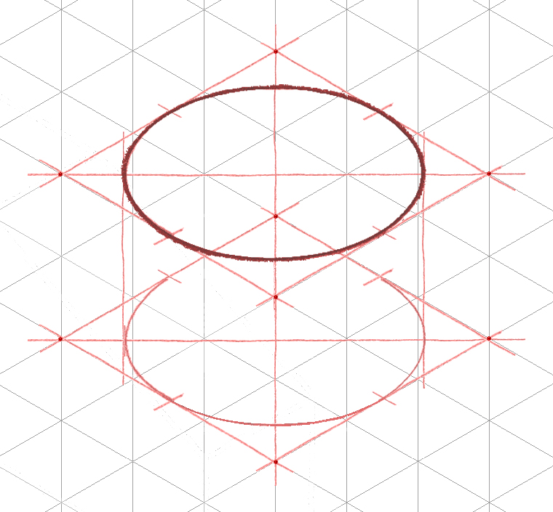
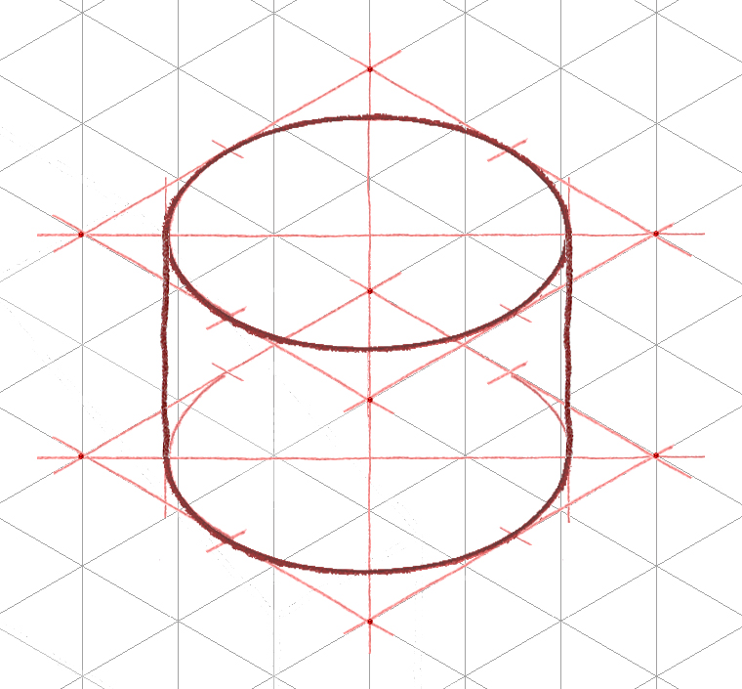
Sketching Isometric Circles
Use construction lines to connect the two ellipses, and to identify where the object line for the second ellipse will begin and end.
Trace out the final object lines.

Slide 35
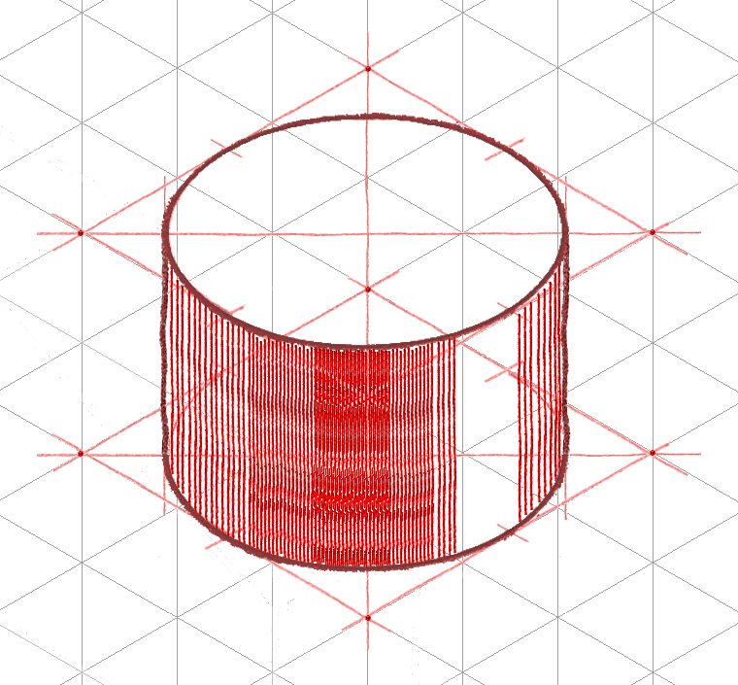
Sketching Isometric Circles
Add tonal shading to curved surface by drawing straight lines between the elliptical faces. Varying the distance between the lines will give the illusion of reflected light.

Slide 36
Circles look distorted because this is one of the issues with isometric drawings: shapes aren’t true shapes!

Slide 37
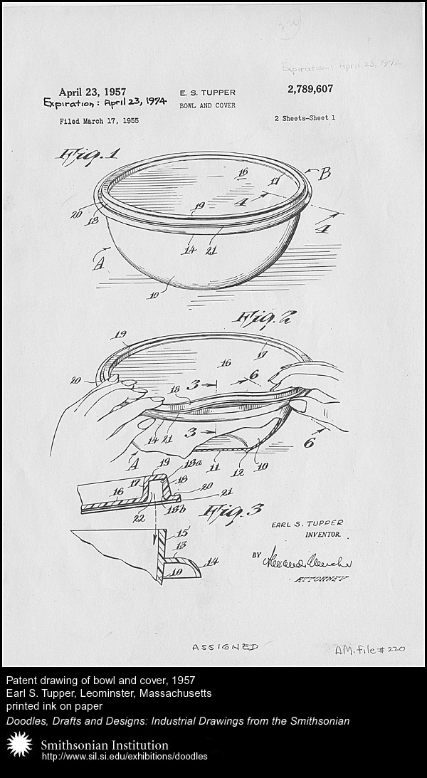
Isometric Sketch Historical Example
Earl Silas Tupper (1907 -1983) invented an air-tight Tupper Seal in 1947
Patent drawings of bowl and cover, 1957 (isometric pictorial)
Courtesy Smithsonian Institute: http://sil.si.edu/exhibitions/doodles
Notes:
37

Slide 38
References
Tupper, Earl Silas. Patent drawings, 1957. Smithsonian Institute: http://sil.si.edu.exhibitions/doodles
Wikipedia (2011). Three point flexural test. Retrieved from http://en.wikipedia.org/wiki/File:Threepoint.jpg
Notes:
38

