Slide 1
Constraints
Introduction to Engineering Design
© 2012 Project Lead The Way, Inc.

Slide 2
Constraints
A constraint is something that limits or restricts.
There are two types of constraints that you might have already encountered:
  Dimensional
  Geometric

Slide 3
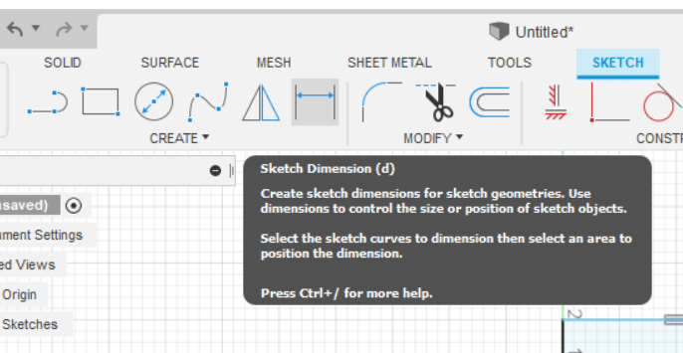
Dimensional Constraints
Dimensional constraints limit the size or position of a primitive.
Examples
  Making one side of a rectangle exactly 2.0 inches
  Making a square primitive exactly 2.0 inches from another square primitive

Slide 4
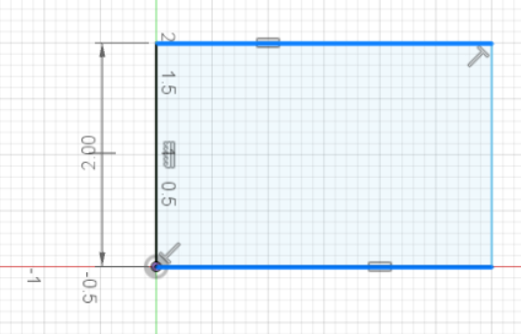
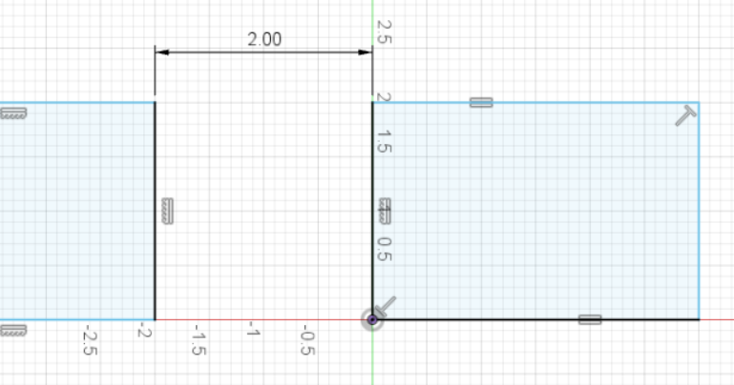
Dimensional Constraints
Dimensional constraints limit the size or position of a primitive.
Examples
  Making one side of a rectangle exactly 2.0 inches
  Making a square primitive exactly 2.0 inches from another square primitive

Slide 5
Geometric Constraints
Geometric constraints apply geometric relationships to sketched elements.
Examples
  Making two lines parallel
  Making two arcs concentric
  Making a line horizontal

Slide 6
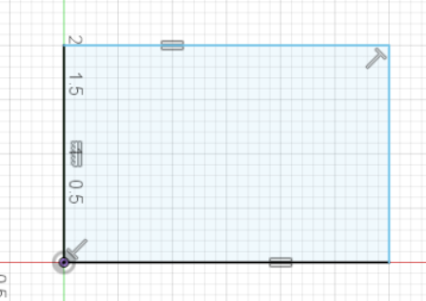
Geometric Constraints
Often times, Fusion360 will automatically apply constraints to your sketch. For instance when drawing a rectangle, Fusion 360 might add constraints that make the opposite lines parallel to each other, adjacent lines perpendicular to each other, the lines are horizontal and vertical, or the endpoints for each line are coincident.

Slide 7
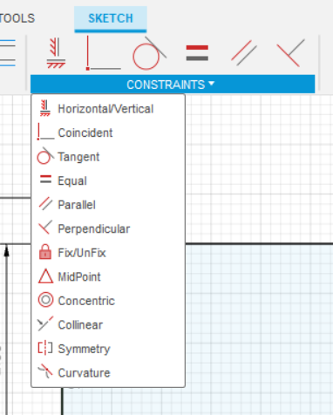
Geometric Constraints
Other times, you may want to manually add the constraints so that your sketch behaves in the way that you want it
Notes:
Show students where this is in the CAD Modeling software.

Slide 8
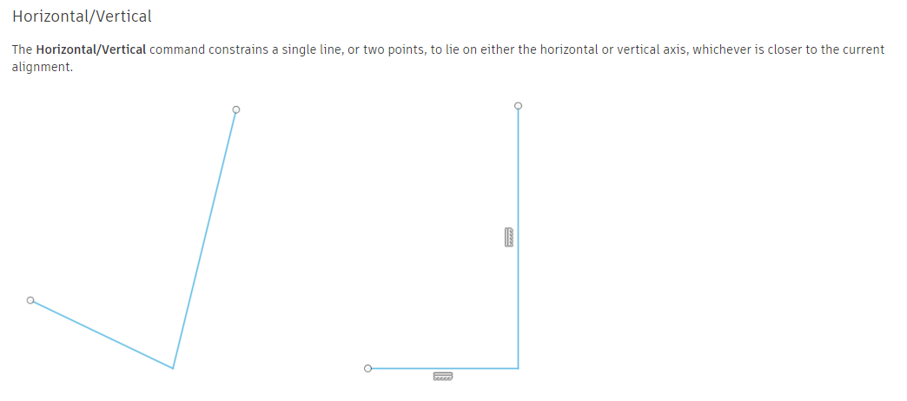
Geometric Constraints
Notes:
Show students where this is in the CAD Modeling software.

Slide 9
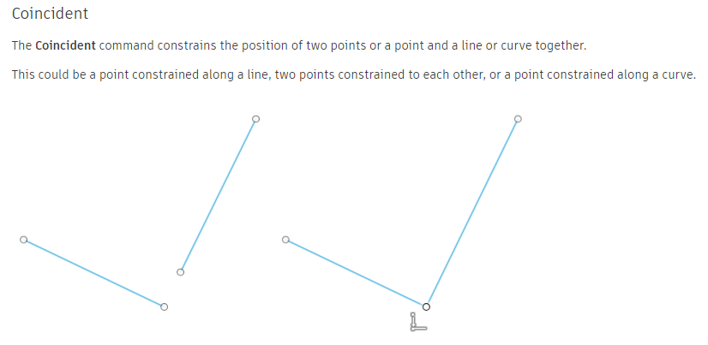
Geometric Constraints
Notes:
Show students where this is in the CAD Modeling software.

Slide 10
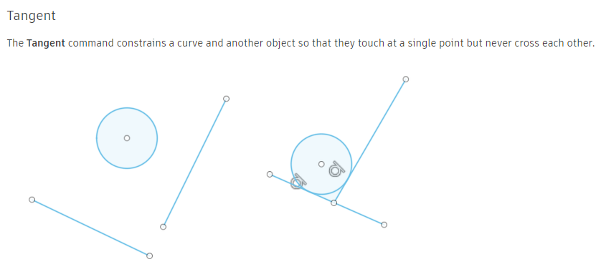
Geometric Constraints
Notes:
Show students where this is in the CAD Modeling software.

Slide 11
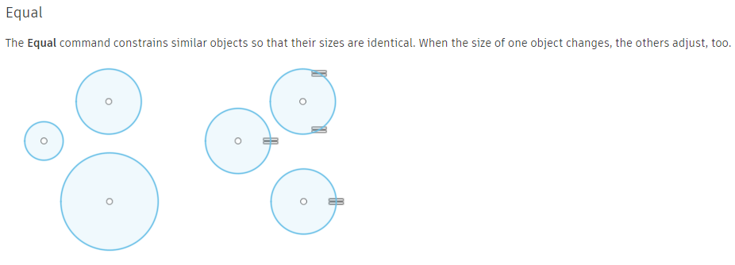
Geometric Constraints
Notes:
Show students where this is in the CAD Modeling software.

Slide 12
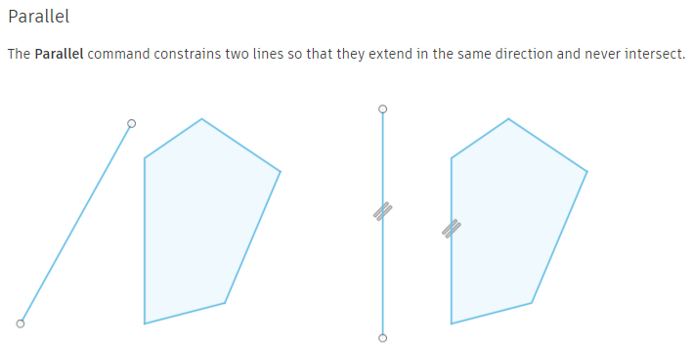
Geometric Constraints
Notes:
Show students where this is in the CAD Modeling software.

Slide 13
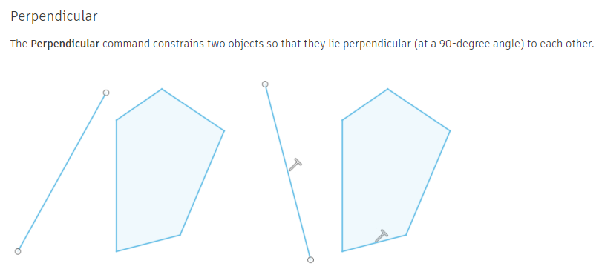
Geometric Constraints
Notes:
Show students where this is in the CAD Modeling software.

Slide 14
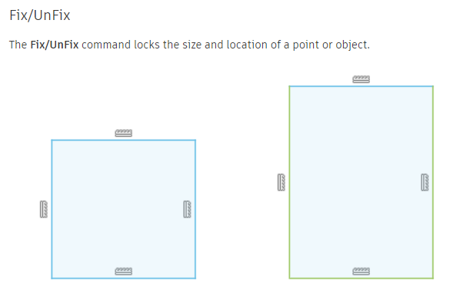
Geometric Constraints
Notes:
Show students where this is in the CAD Modeling software.

Slide 15
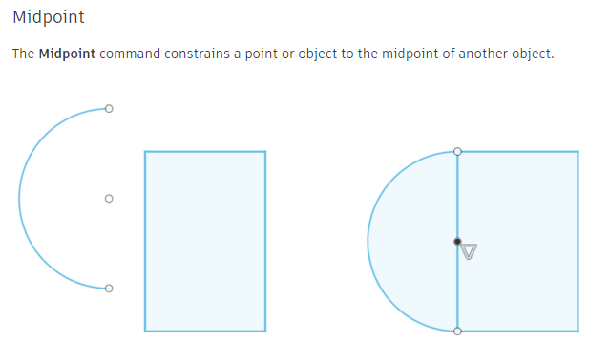
Geometric Constraints
Notes:
Show students where this is in the CAD Modeling software.

Slide 16
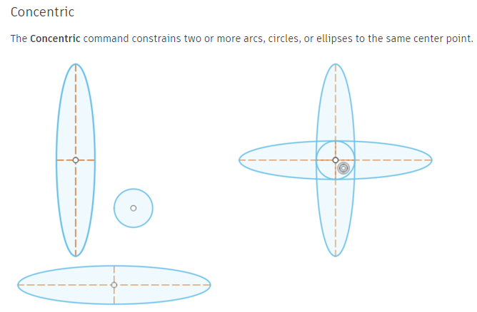
Geometric Constraints
Notes:
Show students where this is in the CAD Modeling software.

Slide 17
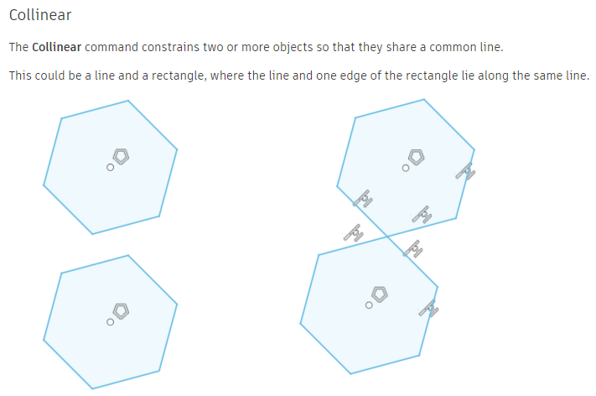
Geometric Constraints
Notes:
Show students where this is in the CAD Modeling software.

Slide 18
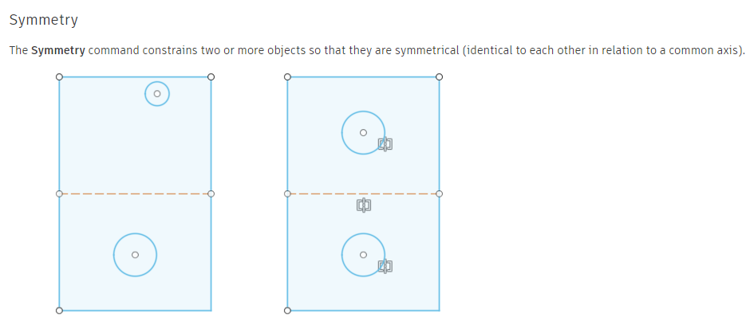
Geometric Constraints
Notes:
Show students where this is in the CAD Modeling software.

Slide 19
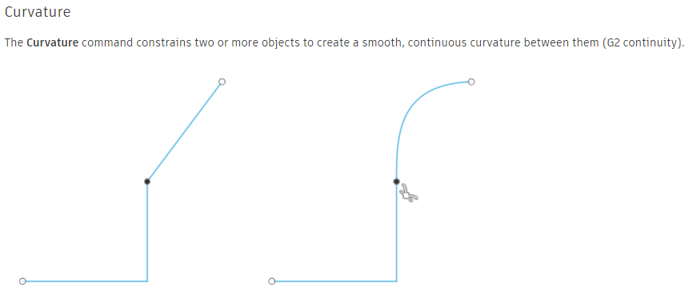
Geometric Constraints
Notes:
Show students where this is in the CAD Modeling software.

Slide 20
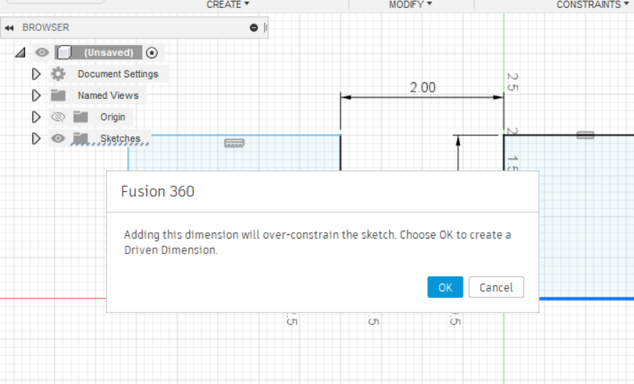
Over-constrained???
Sometimes when you add constraints you may over-constrain the sketch more which means that there are conflicting or multiple rules affecting that part of the sketch
Never ever click OK!

Slide 21
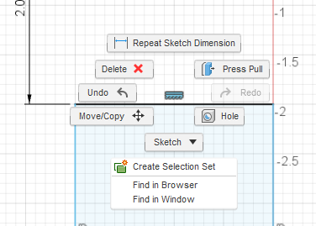
Over-constrained???
When this happens, click CANCEL and then SELECT, RIGHT-CLICK, and DELETE the constraints that you might not need
Then try the constraint again, until it does not give you the over-constrained error message

