Slide 1
Project Management
Introduction to Engineering Design
© 2012 Project Lead The Way, Inc.

Slide 2
Project Management
“Failing to plan is planning to fail.”
-Alan Lakeinn

Slide 3

Project Management
In real life, designs don’t magically come together
Great designs are the result of hard work, cooperation, good management and luck!
Obviously, we can’t manufacture luck but we can control all the other parts

Slide 4
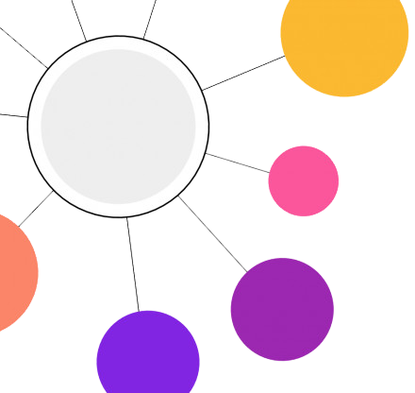
Project Management
Whether in large corporations or small student teams, projects are difficult to manage because tasks may not be completed at the same time, teammates may have different skill levels, stakeholders may change their vision, unforeseen issues may develop etc.
This process is so important that companies spend large amounts of money hiring engineers who simply focus on managing a project.

Slide 5
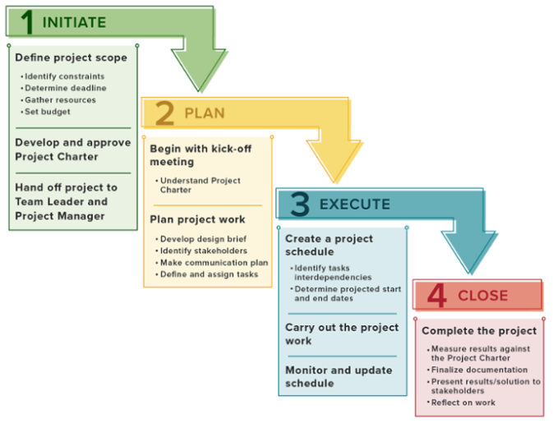
Project Management
As a result, many types of project management methods have been developed
One of the most widely used today in engineering is the waterfall project management method in which a typical project can be broken up in 4 main parts.
However, we will be borrowing from many various types of project management methods for our class

Slide 6
Project Management
A project begins with defining a need or opportunity and developing a design brief which gives the reason for the project and defines the project scope, stakeholders, objectives and constraints (including budgetary and the deadline).
Teams are formed, the team norms are developed, and roles are assigned.
You’ll pick a project manager for your team so that they can direct the project and assign tasks if necessary.
Team norms are the rules that teammates decide upon and will adhere to so that the project runs smoothly and that each teammate does their part.

Slide 7
Project Management
Team norms are the rules that teammates decide upon and will adhere to so that the project runs smoothly and that each teammate does their part.
  Establish a final list of rules through consensus.
  Establish consequences if norms are broken.
Examples of team norms:
  Listen to input from all team members
  Must respond by 9pm every night
  Don’t take criticism personally

Slide 8
Project Management
Next is to plan your Features (or User Story or Criteria) which are things that the end-user would want your design to do for it to be successful.
Use this template: As a <type of user>, I want <some goal> so that <some reason>.

Slide 9
Project Management
Let say our problem statement is like: “According to the CDC, at least 22% of the US population have some kind of disability. Though many newer schools are fully ADA compliant, there are still many older schools whose facilities cannot easily become ADA compliant due to exorbitant costs”
And your design statement is: “Design, prototype, and test a device that enables a person with visual impairments to easily get to the elevators without having to ask people for directions all the time.”
So your features could be: “As an visually impaired human, I want the device to be compact and unsightly so that I don’t awkwardly stand out to others around me.” or “As an visually impaired human, I want the device to silently detect the elevators within 25 feet.”

Slide 10
Project Management
One question that students often have when scheduling a project, is how long each part of a project should take.
In general, a good time management idea is the Rule of Thirds.
This is where we divide up a project’s time budget into three main parts:
  Research & Exploration
  Design & Construction
  Testing, Documentation & Presentation

Slide 11
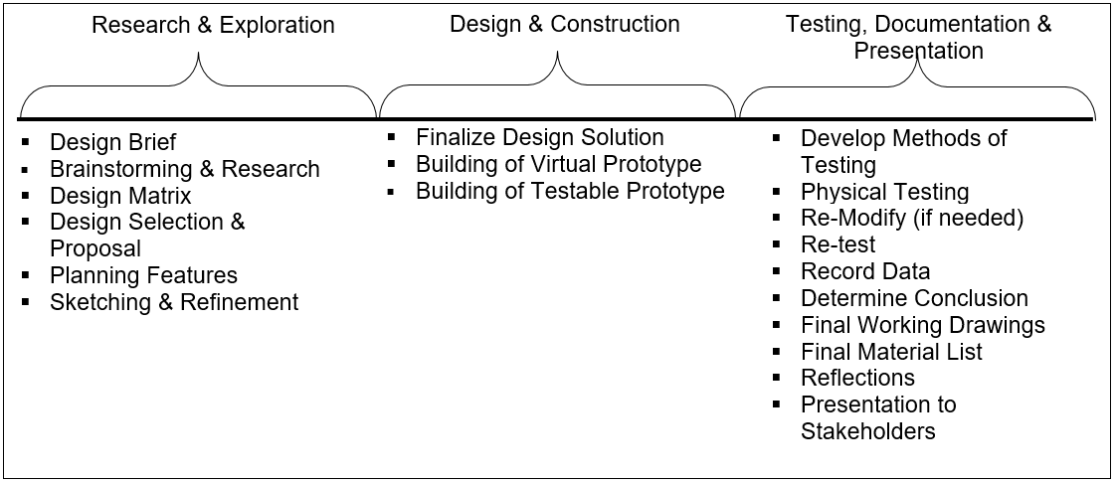
Project Management
So if you have 15 days to complete a project, you’ll want to spend 5 days in each section:
If you are honest with yourself, you’ll probably realize that with most of your projects so far, you’ve probably used a 33%-66%-1% model.

Slide 12
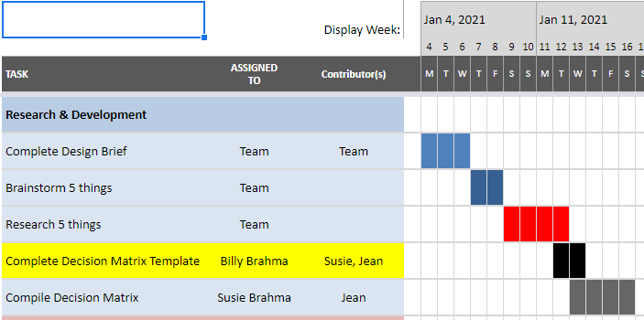
Project Management
Once the deadline is determined, you can take the items from the Rule of Thirds list and organize them into your Gantt Chart
Often one task must be completed before another task can begin, which is known as a dependency. You show this on the Gantt Chart, by making sure the dependency task ends before the next starts.

Slide 13
Project Management
Now refer back to your features, you then define specific backlog tasks that will lead to the criteria being completed.
When you define a backlog task, you need to
  Include a verb so that the task requires an action
  Include a way to quantify successful completion or something produced (deliverable)
For our example feature, the backlog tasks can be:
  Research & acquire a presence sensor module that is smaller than 2 inches in diameter
  Survey at least 25 visually impaired people on where the device should be best located
  Design the presence sensor module holder in Fusion360
  Test the strength of at least 3 materials for the holder by seeing if I can snap it in half
  Test to see if it is unsightly by surveying 25 random people

Slide 14
Project Management
Once you’ve finished your specific backlog tasks, you can add them into your Gantt Chart as subtasks under a category like “Finalize Design Solution” or “Building of Virtual Prototype”

Slide 15
Project Management
When you start carrying out the process to release a product, there are many methods out there to manage, monitor, and adjust to the day-to-day progress of the team.
One such way used by many corporations today is the Scrum Project Management methodology.
Though it is best suited for software development, we’re going to incorporate some aspects of it.

Slide 16

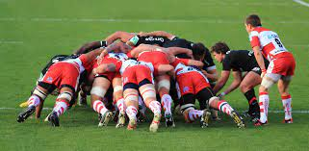
Scrum
Scrum is a style of project management designed to keep large projects moving forward while allowing for different rates of development by individual team members.
The project manager helps keep the entire project moving forward to the larger goal.
It is a term borrowed from rugby.

Slide 17
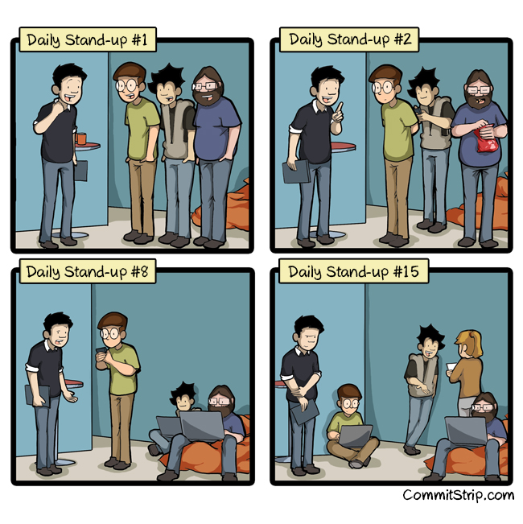
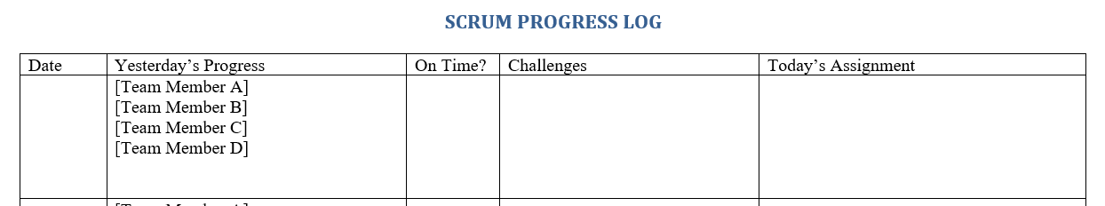
Scrum
Each day before work starts, the team will get together in a short meeting called the Daily Stand-Up to discuss what backlog task they worked on yesterday, what they plan to do today, if they are on schedule, and what obstacles they are grappling with.
For our engineering program, we use the Scrum Progress Log to help keep track of a project by putting the Daily Stand-Up in writing to reduce meeting fatigue.

Slide 18
Scrum
Once a backlog task has been completed, the team member should automatically highlight the row with their color that represents that they have completed the backlog task in the spreadsheet and have the project manager sign off on it.
Then she should find the next backlog task to be completed and start on it. The project manager can also assist in selecting the next task for that team member.

Slide 19
Project Management
Closing a project includes finalizing the project documentation like the working drawings and materials list, and reflecting on the work to help inform future projects. What went well? What did not go well? How can the team improve the process or the outcome for the next project?
The success of the project is evaluated by comparing the results with the design brief. Presenting the project results and getting acceptance from the stakeholders that initiated the project will end the project.

Slide 20
Problems with the Waterfall Method
Though it provides us an easy-to-navigate way of managing a project with a clear-cut goal, it does not allow us make any significant changes since we only get end-user feedback or do testing at the end
So if something major doesn’t work, we’ll have to start over which is costly and causes delays in our deliverables

Slide 21
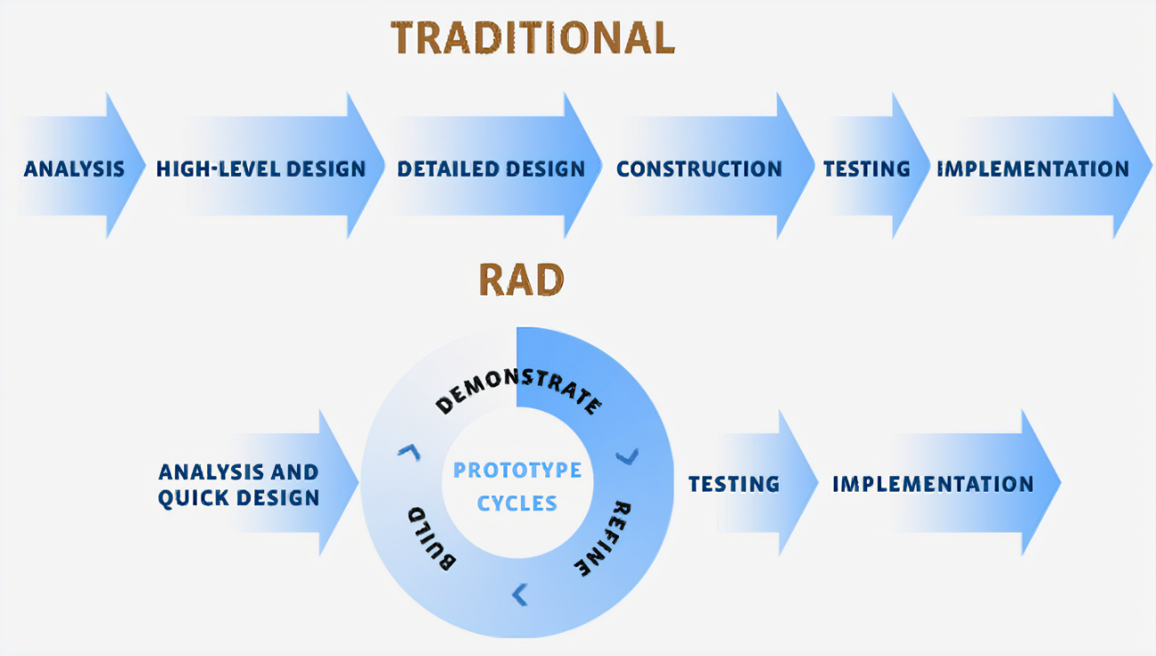
Agile Project Management
Because of some of the issues with the waterfall method, managers have implemented the Agile approach which prioritizes rapid prototype releases and iterations so we can quickly figure what works and what doesn’t

Slide 22
Agile Project Management
So once you figure out the parameters of the project, you want to begin building quick & incomplete prototypes as soon as you can that determine the feasibility of the overall project
Then you want to quickly iterate using the results of testing and feedback from end-users until the final direction is clear

Slide 23
Agile Project Management
Once you have a good grasp of what the prototype should look like, then you can finish the rest of the steps of the waterfall method
This way, there are fewer risks and surprises that can derail your project

