Slide 1
Holes and Hole Notes
Introduction to Engineering Design
© 2012 Project Lead The Way, Inc.

Slide 2
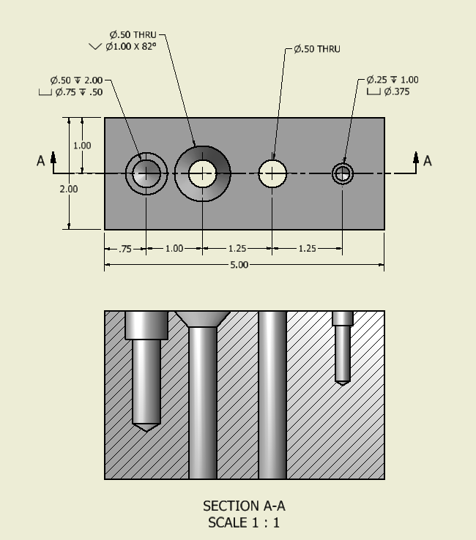
Hole Definitions
Through/Thru
  Hole cuts through entire thickness
Clearance
  Hole large enough to allow screw head (and driver) to pass through
Blind
  Hole does not cut through entire thickness

Slide 3
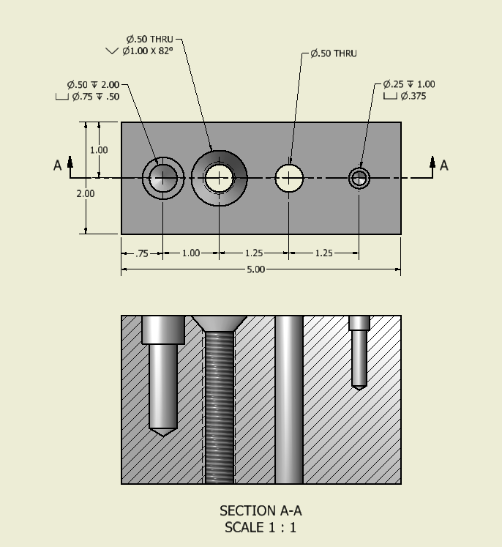
Hole Definitions
Countersink
  Conical-shaped recess around hole at surface
  Often used to accept tapered screw
Counterbore
  Cylindrical recess around hole at surface
  Often used to receive a bolt head or nut
Tapped
  Hole has internal threads

Slide 4
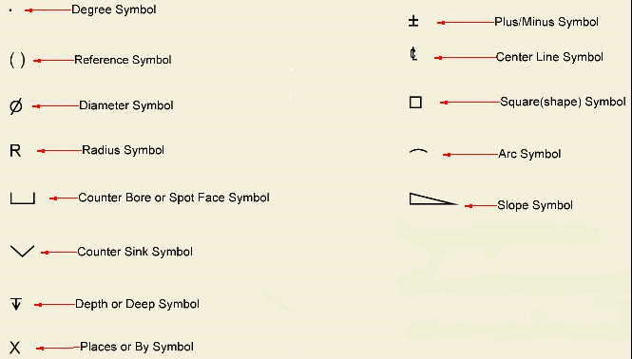
Hole Note Symbols

Slide 5
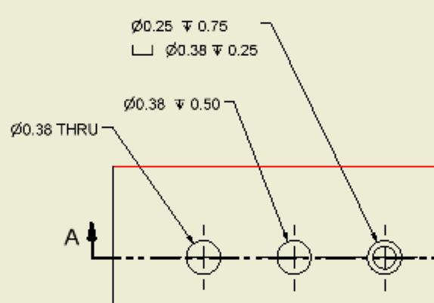
Hole Notes
A 0.25” diameter blind hole is drilled 0.75” deep. Then a 0.38” diameter counter bore is drilled 0.25” deep.
Counterbore or Spotface symbol
Depth
symbol
Notes:
You don’t add the depths together

Slide 6
Hole Notes
A 0.38” diameter blind hole is drilled 0.50” deep.

Slide 7
Hole Notes
A 0.38” diameter hole is drilled completely through the object.

Slide 8
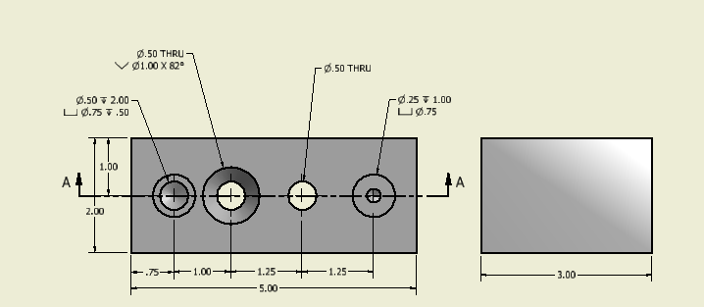
Hole Notes
Countersink or symbol
A 0.50” diameter hole is drilled completely through the object. Then a countersink is created with a 1.00” diameter at the surface and tapering at 82º.

Slide 9
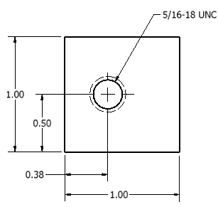
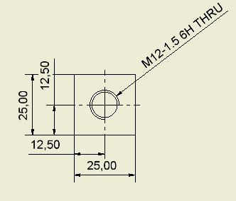
Thread Notes
Thread are dimensioned with the use of local notes.
Two methods
  Unified National Thread method
  ISO

Slide 10
Unified National Thread Notes
Thread per Inch
Major Diameter
Coarse or Fine threads. In this case C for course, F is for fine.

Slide 11
ISO Thread Notes
1.5, Pitch of the threads
12, Nominal Diameter in mm
Prior to THRU may appear an LH for Left Hand thread
M for Metric
H, allowance. H means no allowance, G means tight allowance.
6, Grade of tolerance in the threads. Can be whole number from 3 to 9.

