Slide 1
Line Conventions

Slide 2
Line Conventions
Lines of varying style and thickness are used in specific ways to develop and communicate graphic messages about an object’s geometry. The next few slides show some basic line conventions and their use

Slide 3
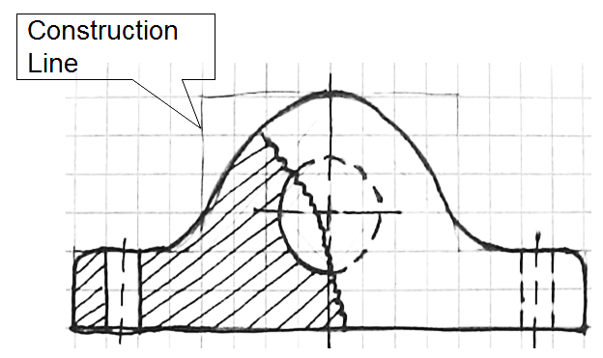
Construction Line
Very lightly drawn lines to guide drawing other lines and shapes

Slide 4
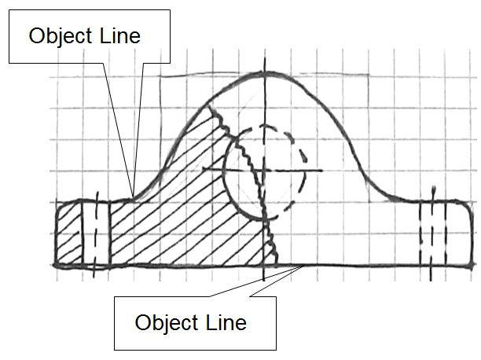
Object Line
Thick and dark
Define the object

Slide 5
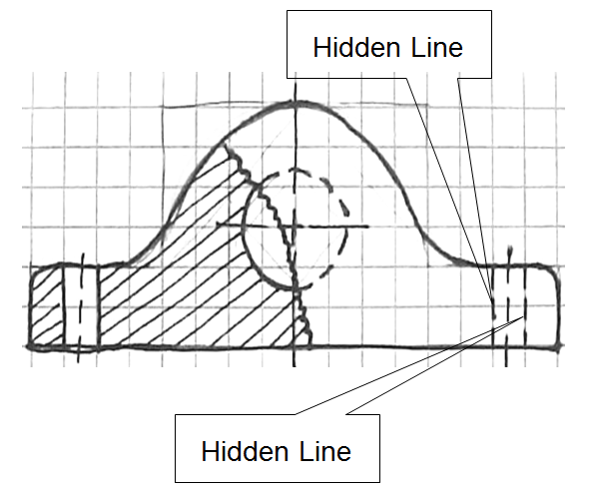
Hidden Line
Show interior detail not visible from the outside of the part
What are these hidden lines trying to tell you?

Slide 6
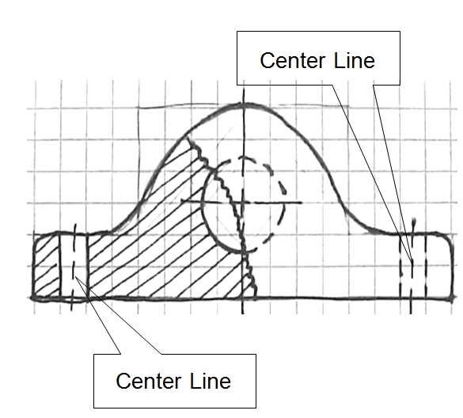
Center Line
Define the center of arcs, circles, or symmetrical parts
Half as thick as an object line

Slide 7
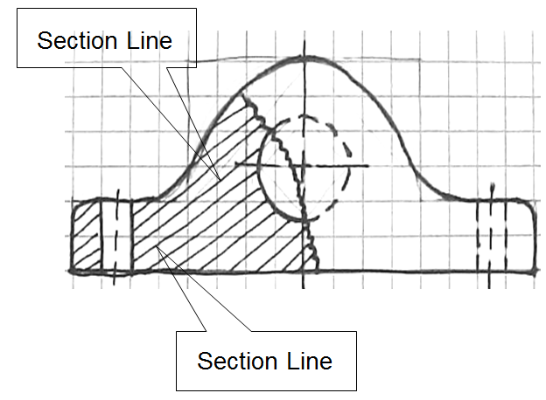
Section Line
Define where material is cut away

Slide 8
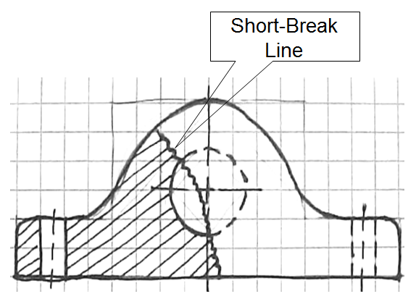
Short-Break Line
Freehand drawn line
Shows where part is broken to reveal detail behind the part or to shorten a long continuous part

Slide 9
Line Conventions
What is a dimension?
How do we show it in a diagram?
What if you want to dimension a circle or arc?

Slide 10
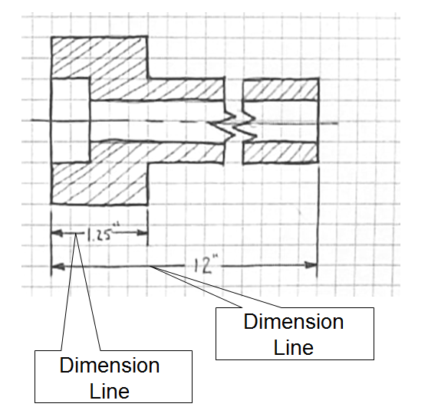
Dimension Line
Shows distance
Arrows drawn on ends to show where dimension line starts and ends
Actual distance is typically located in middle of this line to display distance

Slide 11
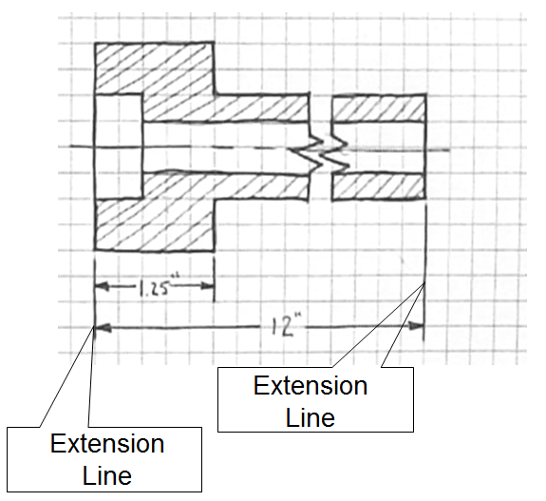
Extension Line
Shows where a dimension starts and stops
Used with dimension lines
Line is 1/16” away from part to avoid confusion with object lines

Slide 12
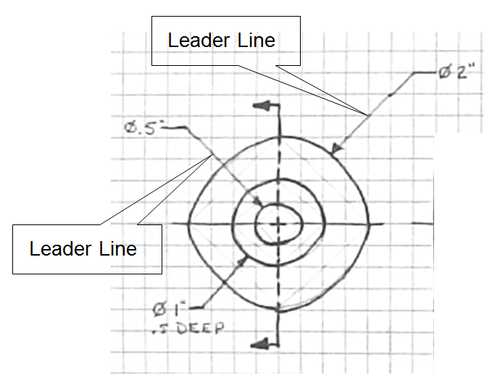
Leader Line
Show dimensions of arcs, circles and detail
How is it different than a dimension line?
What do you think the symbol is?

Slide 13
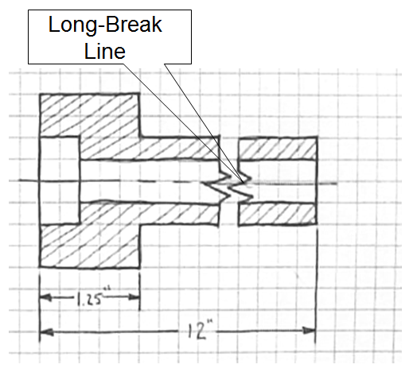
Long-Break Line
Shorten very long objects with uniform detail
Typically represented as a jagged cut or break

Slide 14
Line Conventions
These standards relate to technical drawing (more precise than freehand sketching)
Use these standards as a guide when sketching

Slide 15
Precedence of Lines
Complex object sketches may require different line types to overlap
Line precedence must be used
Rules that govern line precedence in sketches and technical drawings
  Object lines take precedence over hidden and center lines
  Hidden lines take precedence over center lines
  Cutting plane lines take precedence over all others

Slide 16
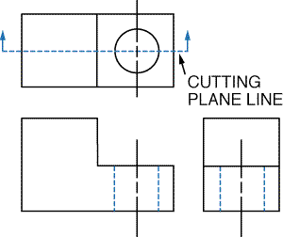
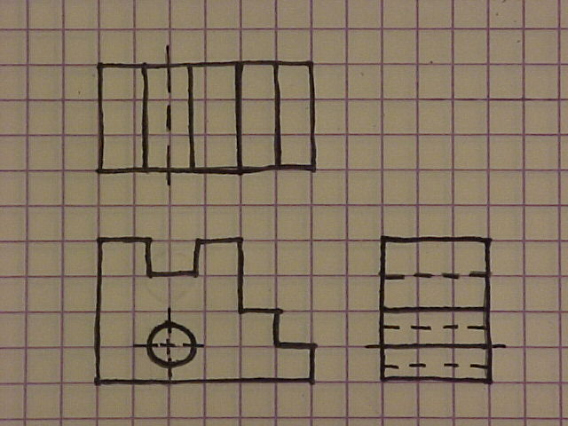
Precedence of Lines Examples
Object lines has precedence over hidden lines
Object line has
precedence over center line

